Slide 1

BEHAVIOURAL ANALYSIS WEEK 2020 ONLINE
Head Movement Vibration Analysis
Yana Nikolaenko,
Professor of Raoul Wallenberg Institute of Special Pedagogy and Psychology and Chief Psychologist at Elsys Corp., Russia
Notes:
Dear colleges! My name is Yana Nikolaenko and I present head movement vibration analysis by vibraimage technology for detection of emotions, behavior and intentions. Vibraimage systems are using for suspicious passengers detection in airports from 2007 year.

Slide 2
Physiology of activity
Reflex movements associated with emotions.
(The expression of the emotions in man and animals, 1872)
Charles Darwin
Every thought reflects as muscular movement. (Reflexes of the brain, 1863)
Ivan Sechenov
A person does not have random movements.
(The Interpretation of Dreams, 1899)
Sigmund Freud
Human movements are discrete in time, as they are corrected
by feedback. (Biomechanics research, 1935)
Nikolai Bernstein
Psychophysiological processes are associated with the exchange of energy and information within or between physiological systems of a person. (Cybernetics: Or Control and Communication in the Animal and the Machine, 1948)
Norbert Wiener
Amplitude and intensity of reflex movements characterized
aggression. (On Aggression, 1966)
Konrad Lorenz
Notes:
Vibraimage technology based on several physiological and technical points. Greatest scientists and physiologists of the past paid attention on Physiology of Activity and reflex movements processing as nonverbal indicator of human thoughts, emotions and intentions.
The technical aim of vibraimage technology was human reflex movement calculation by video image processing.

Slide 3
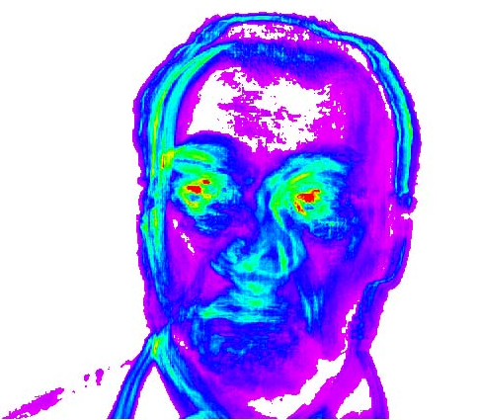
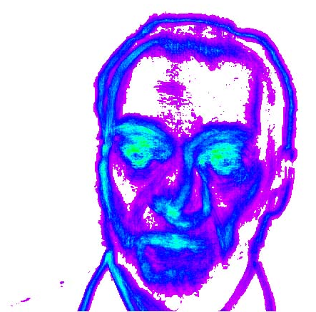
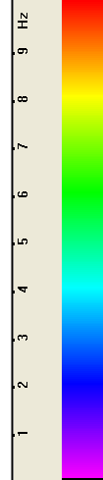
VibraImage technology
Vibraimage is emotions detection technology based on video image processing
Amplitude vibraimage
Frequency vibraimage
Frequency
scale
(Minkin&Nikolaenko (2008). Application of Vibraimage Technology and System for Analysis of Motor Activity and Study of Functional State of the Human Body. Biomedical Engineering. Vol. 42. No. 4. P. 196-200)
Notes:
Vibraimage technology analyzes the movements and vibration parameters of a subject. The amplitude and frequency components of the vibraimages are parallel video streams similar in image format to the original video. Each frame of the amplitude and frequency component contains temporal and spatial information about the past of this video stream, limited in time by the number of inter-frame difference accumulation.
Vibraimage processing transforms these video streams into emotional and psychophysiological parameters of a person.

Slide 4
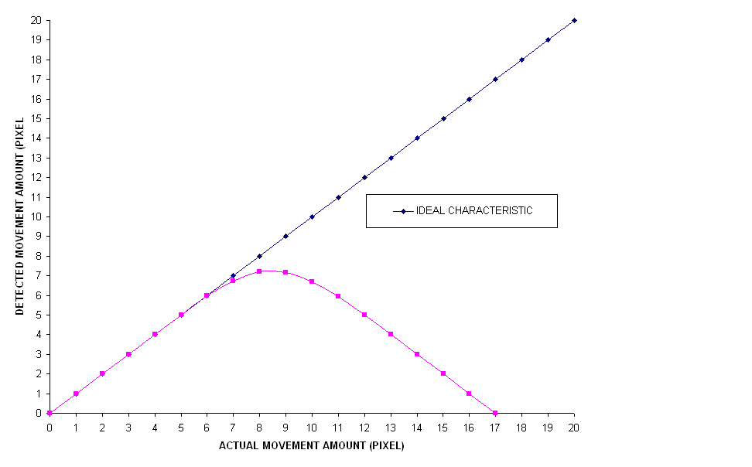
Frame difference accumulation as movement amount measure
Frames sequence
y
T₁
x
y
T₂
x
y
Δ
Frame difference dependence from the movement amount
(Sekine et al. US5,861,916)
x
Inter-frame difference frame has the same size as original video image
Notes:
The first technical base of vibraimage technology is real time inter-frame difference accumulation by video image processing. Frame difference is proportional to the micro movements, but for macro movements is low dependence between movements and accumulated frame difference. Thus, macro movements have not much affect to the accumulated inter-frame difference.
Movement amount – frame difference dependence is clearly visible in the presented graph.

Slide 5
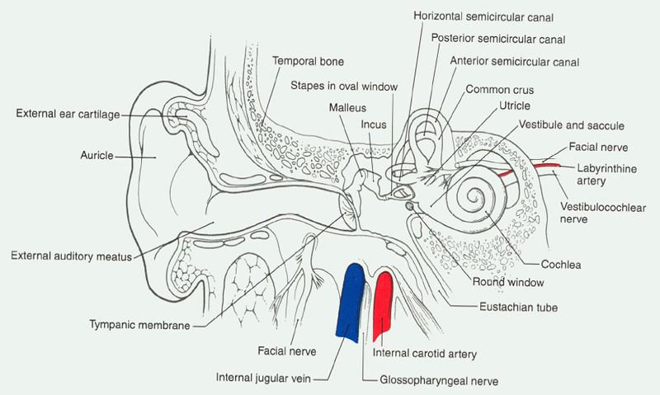
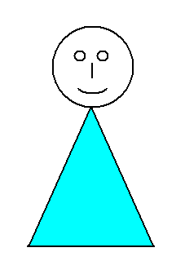
Vestibulo-emotional reflex (VER)
Movements, micromovements
TV camera
Minds, intents, emotions
VibraImage
Image processing
Emotional status
VER
Notes:
Vibraimage developers supposed that the frequency and head movement parameters depend on emotions and psychophysiological state of a person, so this dependence was called vestibulo-emotional reflex, because head micro movements are control by human vestibular system. Head movement analysis combines advantages of behavioral and physiological analyses, it is enough simple, friendly and high informative.

Slide 6
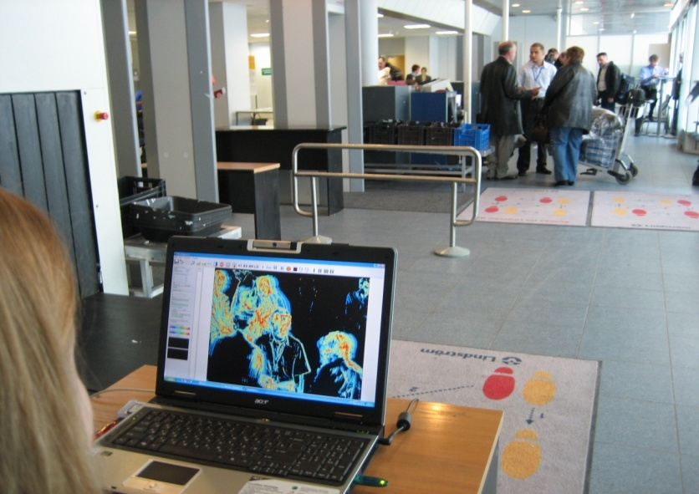
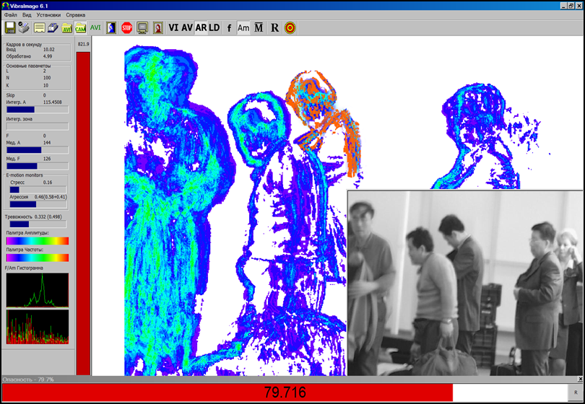
VibraImage application in aviation security
Vibraimage on Pulkovo airport, St. Petersburg, Russia, 2007 year
Notes:
Vibraimage systems are using in aviation security from 2007 year. The first vibraimage system was installed in Pulkovo airport, St. Petersburg, Russia.
Currently vibraimage systems operate in airports of Russia, Japan, China and Korea for detection of suspicious passengers.
Also vibraimage systems are operating in the other different fields.

Slide 7
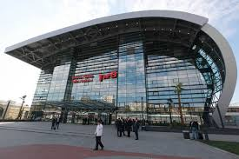
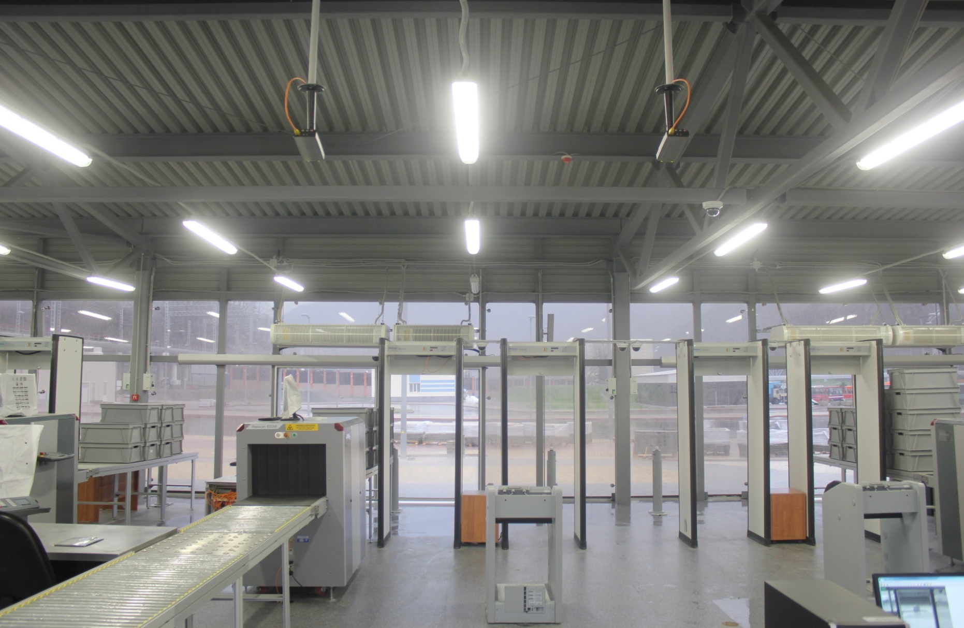
VibraImage on Sochi Olympics
17 checkpoints pavilion.
262 VibraImage IP cameras.
131 computer places with VibraImage.
Every visitor security checking!
Notes:
Vibraimage systems were successfully used for 100% visitors checking during Sochi Olympics in 2014. The organization of visitors control was done as standard airport security in pavilions specially built for the security checking.
Low noise IP cameras from Axis were installed in front of visitors manual checkpoints. The distance between person and camera was about 5 meters. High facial resolution is important for accuracy detection of head movement and incorrect cameras position is the most popular mistake in vibraimage security control.

Slide 8
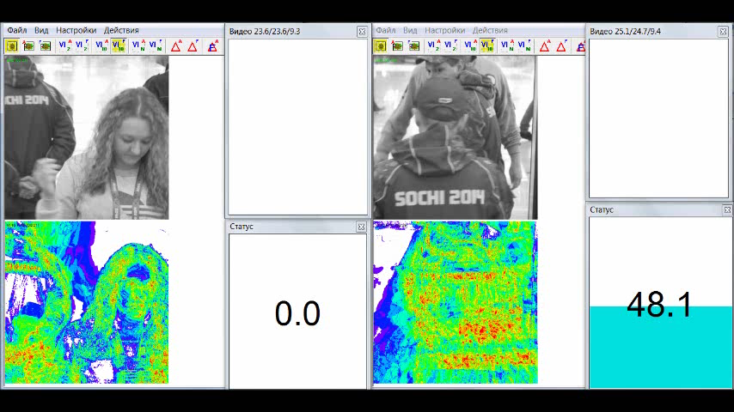
Vibraimage security on Sochi Olympics
Monitor shows images from two nearest cameras and security statuses of checking persons. Systems were adjusted for threshold of security status less 60% for normal visitors.
Notes:
The level of Suspect for every visitor was checked by vibraimage system together with manual control of prohibited things. By the regulation, the increasing of Suspect level requested the second stage personal interview of visitor. Suspect level processing includes Aggression, Stress and Anxiety levels calculation during about 10 seconds.
The threshold of Suspect level depends on several factors and could be changed on every checkpoint. One construction for every checkpoints allowed to use standard settings for 95% of vibraimage systems in Sochi Olympics. However for other airports checkpoints usually is necessary to provide trial testing period for adjusting optimal vibraimage settings in every place.

Slide 9
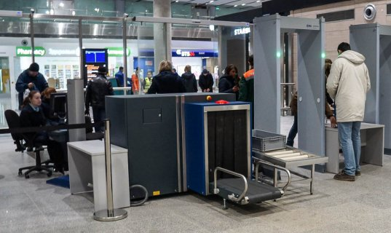
Vibraimage control results on Sochi Olympics
2 700 000 visitors passed control.
120 000 visitors in day during peak loading.
Maximum load was 1200 people in day on 1 workplace.
Person checking and decision making time: 5-10 seconds.
5-15 capturing per day in 1 place of control.
92% of the persons captured by VibraImage system have violations detected on the second control stage (from them 76% - the forbidden objects, 12% - incorrectly processed documents, 8% - abnormal behavior, 4% - another) were revealed.
Error probability (false rejection rate, FRR) has not exceeded 8%. (FAR=0!)
Notes:
During Sochi Olympics was not registered any incidents on the sport object so is possible to note that vibraimage security checking successfully solved given task. The total error rate about (5-10)% for suspicious person detection confirmed in Sochi Olympics for vibraimage control is near the same that is fixed on other objects like airports and security objects for one level of control.
False acceptance rate for vibraimage was zero during month control of about 3 millions people during Sochi Olympic and Paralympic games.

Slide 10
Periods of head movement informativity
time | Control emotions | Program modes | analysis | location
1-8 s | Aggression | MID MIX | Head and body movements | Airport halls, passengers transition
8-60 s | Aggression, Stress, Anxiety, etc | MED, PRO | Head micro movements | Passport and laggage control, Passengers on place and line
60-600 s | Response to Relevant and Irrelevant Stimuli | PRO, NLP | Analysis of face micromovements by 16 parameters | Border control, Auto Checking Kiosks
Notes:
Vibraimage as any other technology of technical profiling needs to have more information about investigated subject for higher detection accuracy.
Vibraimage video duration (Period) is proportional to accuracy of detection, it is impossible to have high accuracy of emotions detection for the short time of person control. There are several vibraimage modes (or security levels) specialized for the different time of passengers control during airport security checking.
I want to tell more about these modes in aspects of aviation security.
Different levels of security checking is the standard approach for airport security because it is impossible to provide 10 minutes security checking for every passenger. Only complex solution combining light or fast checking for everybody and detail checking for suspicious passengers provides high security and normal function in airports.

Slide 11
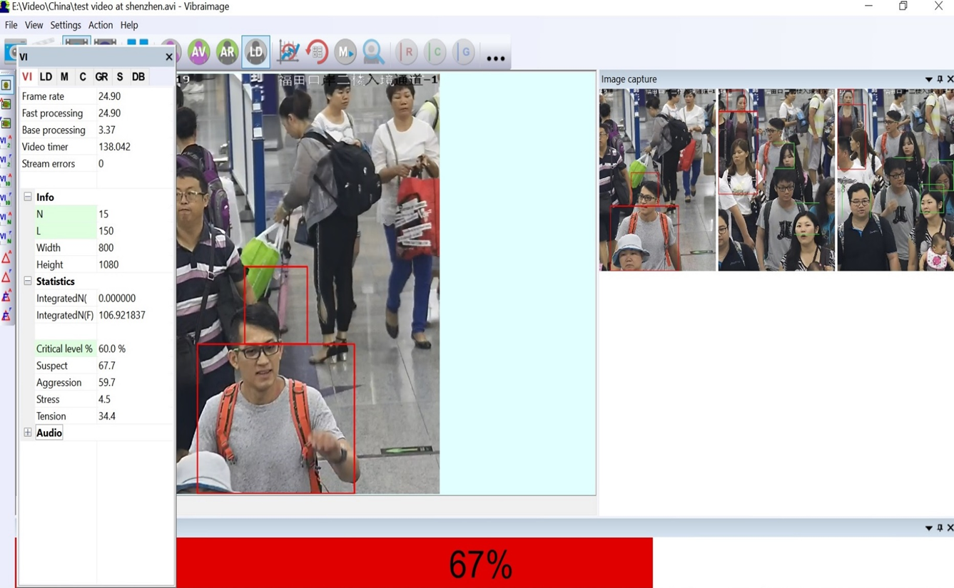
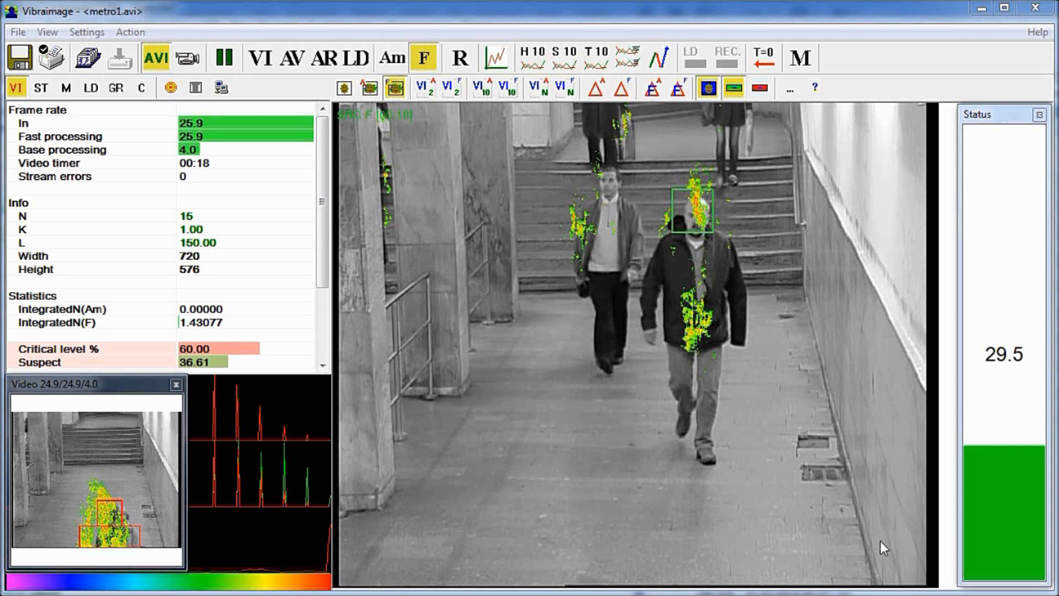
Fast vibraimage control (<10 s)
Suspect level higher than threshold
Suspect level lower than threshold
Notes:
Fast passenger video processing allows to detect people greatly differs by movements from the general level.
The accuracy of one short control (3-8 seconds) is about 80% and is not enough for passenger capturing as suspicious person.
However several capturing of one passenger by different cameras could be the reason of more detail passenger control depends on concrete airport regulation norms.
Vibraimage technology often combine with face detection technology in one system solution.

Slide 12
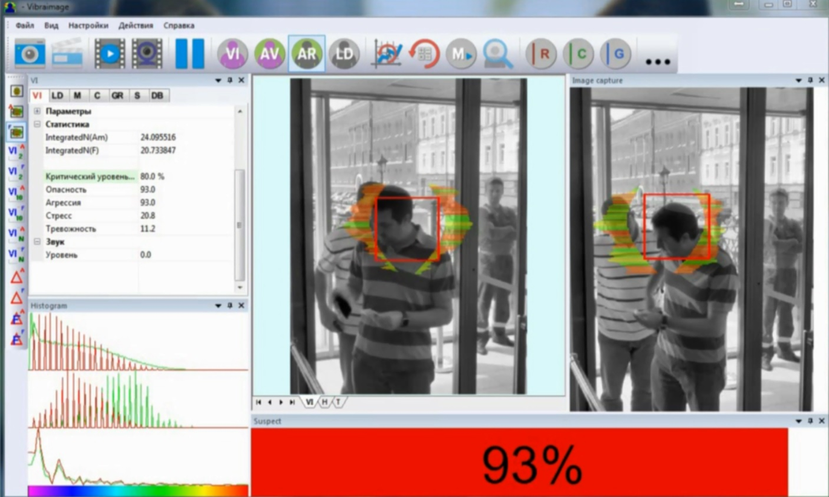
Middle vibraimage control (10-60 s)
Notes:
There are several places in airports were passengers are staying in the fixed places like on security checking, luggage control, tickets control and passport control. Fixing person in one place is important for high accuracy vibraimage control of head movements because for low error rates is need to have head resolution on video higher than 200 pixels on line. Vibraimage monitoring of a person more than 20 seconds give the accuracy of emotion detection higher than 90% and high suspect level on this stage of security checking is enough for capture person to the detail examination.

Slide 13
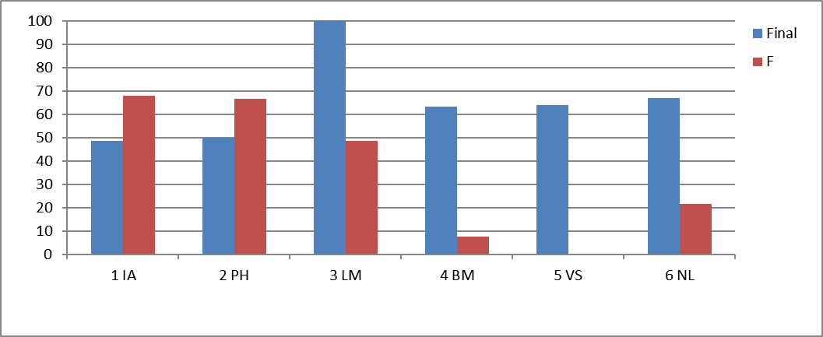
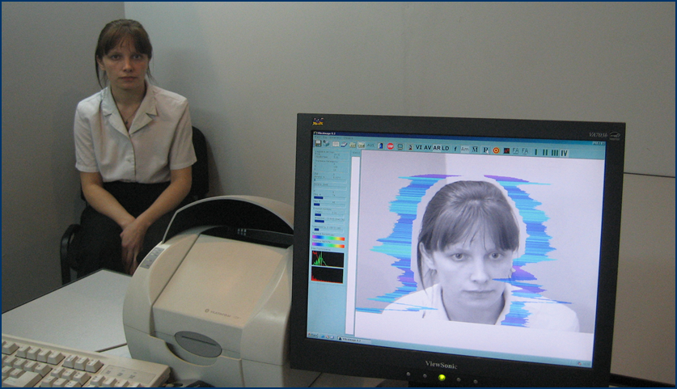
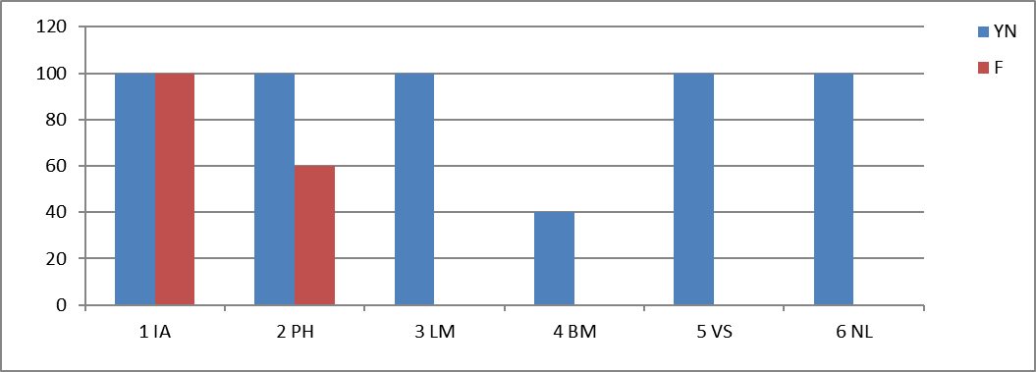
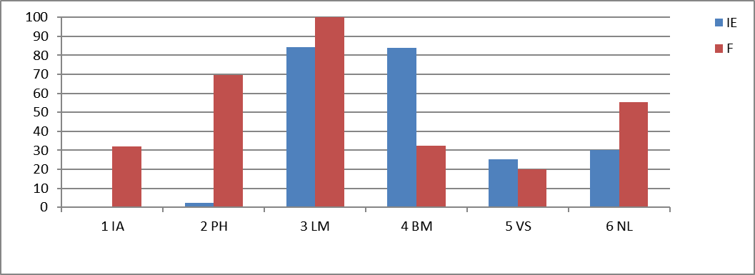
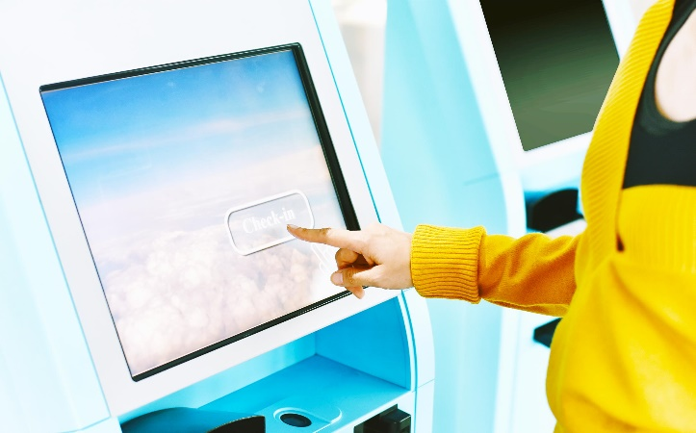
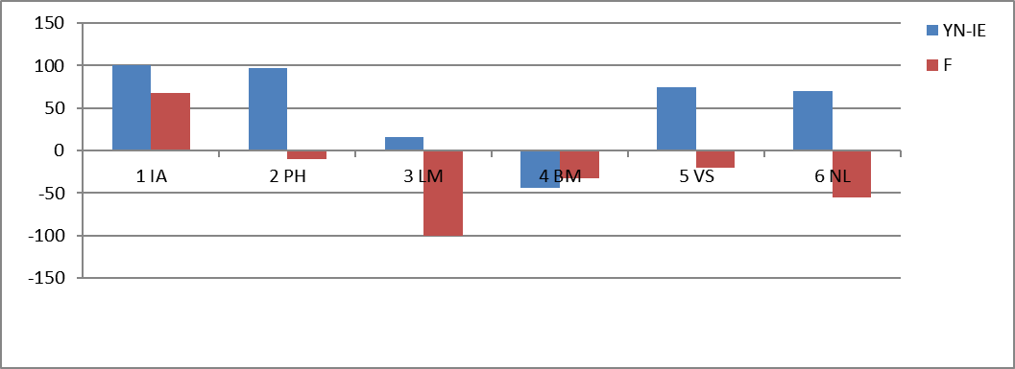
Detail vibraimage control (>60 s)
Interview by AVS
self-testing kiosk
Notes:
Vibraimage developers suggest different programs (NLP, MI, PA) analyzing conscious and unconscious response of users to the presented stimuli. Such programs detects criminal and terrorist intentions of subjects and are using in airports on the 3rd level of passengers control as individual interview or auto self-testing.
The main task for vibraimage technology as for any other behavior detection technology is the development of self-auto-checking points or kiosks with low checking time and high accuracy of hostile intents or predisposition to terrorism.
Current synchronize analysis of a person conscious and unconscious responses to stimuli done by vibraimage processing gives 95% of accuracy during about 7 minutes testing. Vibraimage developers supposed to have the same accuracy during 1-3 minutes testing after 5-10 years of next developments.
I think that after 10 years intentions detections would be practically realized as current biometric identification by fingerprints or facial recognition.

Slide 14
Vibraimage challenges
Low noise digital cameras (dynamic range of noise, not less than 80 dB)
Stable and uniform illumination (no more than 1 lux/s, at an illumination level of at least 500 lux on the object)
Low level external mechanical vibration of camera
High sensitivity for external movement in frame
Real-time operation requires at least an Intel Core i5 processor to process one video flow
Notes:
Vibraimage is real time video processing technology and any video processing requests high processor power and high quality video.
For successful work with vibraimage systems, users must strictly follow the simple rules listed in vibraimage Manuals.
In some countries behavior detection technologies are prohibited or undesirable in application its also limits vibraimage distribution.

Slide 15
Vibraimage advantages
Contactless and remote emotions, behavior and intentions detection
Real time behavior analysis and alarm signal after suspicious person detection
Video recorded information analysis
Standard video devices and computers requested
Open or hidden subject control
Friendly technology for subjects
Notes:
Vibraimage is friendly for subjects and informative for users. It gives unlimited possibilities in behavior analysis for developers and security specialists. This is important tool for profilers, psychologists and aviation security services.

Slide 16
Conclusion
Head movement video analysis combines behavior and physiology features of a person
Vibraimage technology is one of most informative behavior detection method from video analytics
Vibraimage technology suggests different solution for different objects and applications
Vibraimage technology requests high knowledge for installation and is simple for users
Vibraimage gives great abilities for the next developments and applications
Notes:
Vibraimage technology combines technical, physiological and psychological features in one solution.
20 years of vibraimage development showed great progress in science and practical applications for security. I think that it is only the start of vibraimage and next years give more distribution of vibraimage systems for behavior analysis, so as in psychology and health applications.

Slide 17
Thanks for your attention!
Prof. Yana Nikolaenko, Raoul Wallenberg Institute of Special Pedagogy and Psychology, Russia
nikolyana81@mail.ru
www.psysmaker.com
Notes:
Thank you for the attention! You can write me any questions for the given contacts or in the chat.

