Slide 1


The 2nd International Open Science Conference
The Vibraimage Technology
REVIEW OF VIBRAIMAGE TECHNOLOGY APPLICATIONS
Viktor Minkin
Elsys Corp, Russia, Saint Petersburg
2019
Notes:
Dear Colleagues. I am pleased to welcome you at the English day of the second vibraimage conference. It is nice to note that the second vibraimage conference is more representative, perhaps for the third conference we should change the format or make it longer. This year, the first English report at the conference will be the review of vibraimage technology applications.

Slide 2
Vibraimage application fields
Vibraimage technology is more than effective psychophysiological state (PPS) detection
Everything flows, everything vibrates!
Notes:
Any effective technology for assessment of the psychophysiological state (PPS) of a person has unlimited applications. At the same time, the vibraimage technology is more than the effective detection of PPS, which means its capabilities are doubly limitless. There is no such area of ​​knowledge or applications where is impossible to use the vibraimage technology. Therefore, it is necessary to develop methods for classifying of vibraimage technology applications.

Slide 3



Vibraimage apps classifications
By type of study object
Human
Animals
Biology
Things
By action type
Without feedback
With feedback
3
Notes:
One of the main principles for vibraimage technology application classifying is the classification based on the study object. Of course, the main object of study for vibraimage technology is a person. The ability to analyze the parameters of a person psychophysiological state creates the possibilities for the development of vibraimage as an independent technology of psychophysiological detection. As any objects have vibrations, you just need to be able to analyze them correctly.
Since, in its technical essence, the vibraimage technology is the technology for measuring vibrations, the classification used for measuring systems is applicable to it. One of the main principles of measuring systems classification is the principle of direct or balanced measurement, by feedback. Some vibraimage products are based on direct transformation (for example, vibrations into emotions), other programs are based on analysis of psychophysiological responses feedback upon presentation of additional stimuli.

Slide 4
Vibraimage apps classifications
By locality/globality of measuring system
Local (standalone)
systems
Net (global)
systems
According to the principle of camera fixing
Fixed camera
Without camera fixation
Notes:
The structure of vibraimage systems can be based on various principles, first of all, autonomous or local vibraimage system and network or global solutions can be distinguished. Since, the vibraimage system is based on software processing of video images, its structure can be as diverse as the structure of various computer systems.
One of the basic principles of vibraimage technology is television camera fixation, which is necessary for the correct analysis of an object vibration. However, for several apps information about camera vibration is informative, so the principle of television camera fixation can be used for classification.

Slide 5
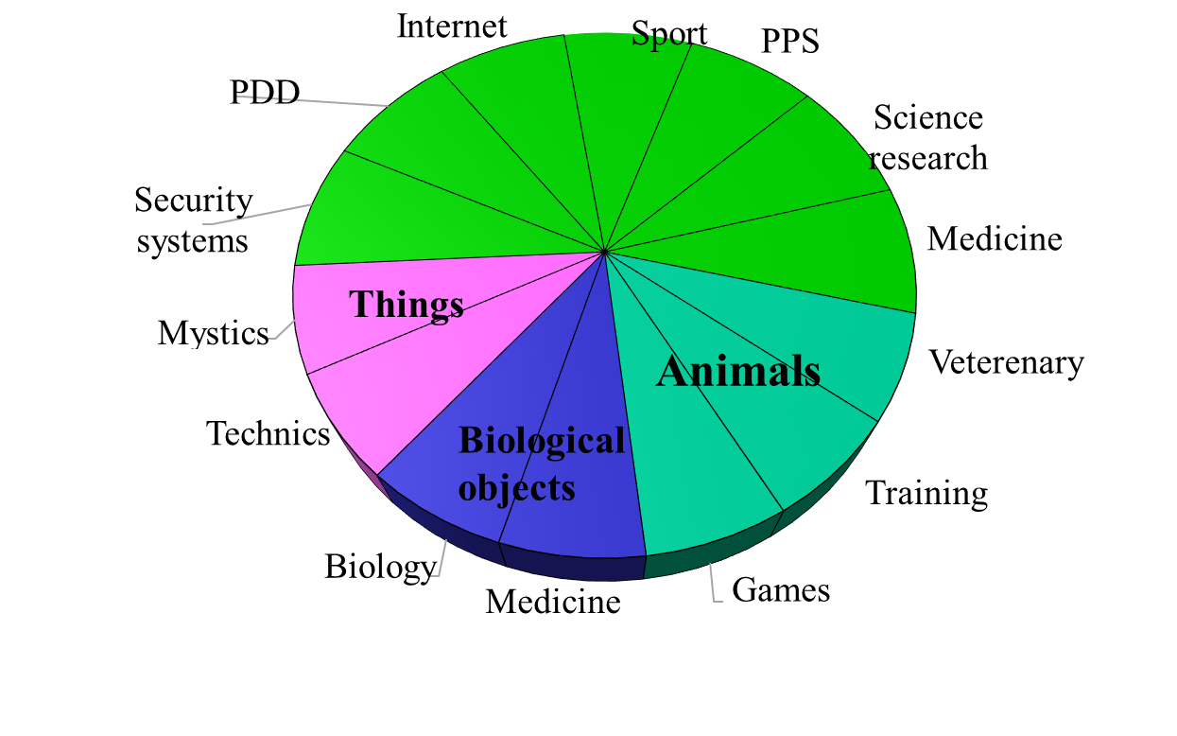
Apps classification based on the type of study object
Human
Pie Chart of VibraImage Applications
Notes:
We use the classification type for the object under study as the main one for further consideration, as it most fully reveals the various applications of the vibraimage technology. From the above pie chart, it follows that the most part of vibraimage technology applications are associated with the study of a person and the analysis of personality, or parameters of psycho-emotional or psychophysiological state.
At the same time, analysing of animals, biological and non-living objects by vibraimage technology also has certain advantages over methods used earlier for solving the similar questions.

Slide 6
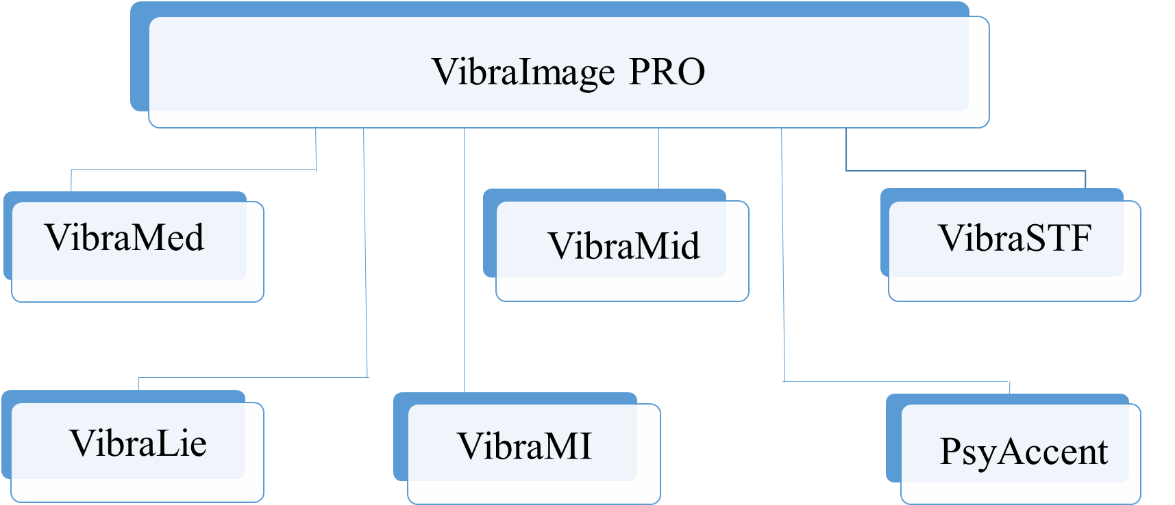
Apps classification based on vibraimage programs
PC based vibraimage programs
Notes:
Used classification methods have found application in the developed programs of Elsys Corp. The main program Vibraimage PRO includes direct-action applications as VibraMed, VibraMid and VibraStaff defining the natural psycho-physiological state of a person.
VibraLie, VibraMI and PsyAccent programs measure the psychophysiological state parameters when requested stimuli (visual and textual or verbal) are presented to a person.

Slide 7
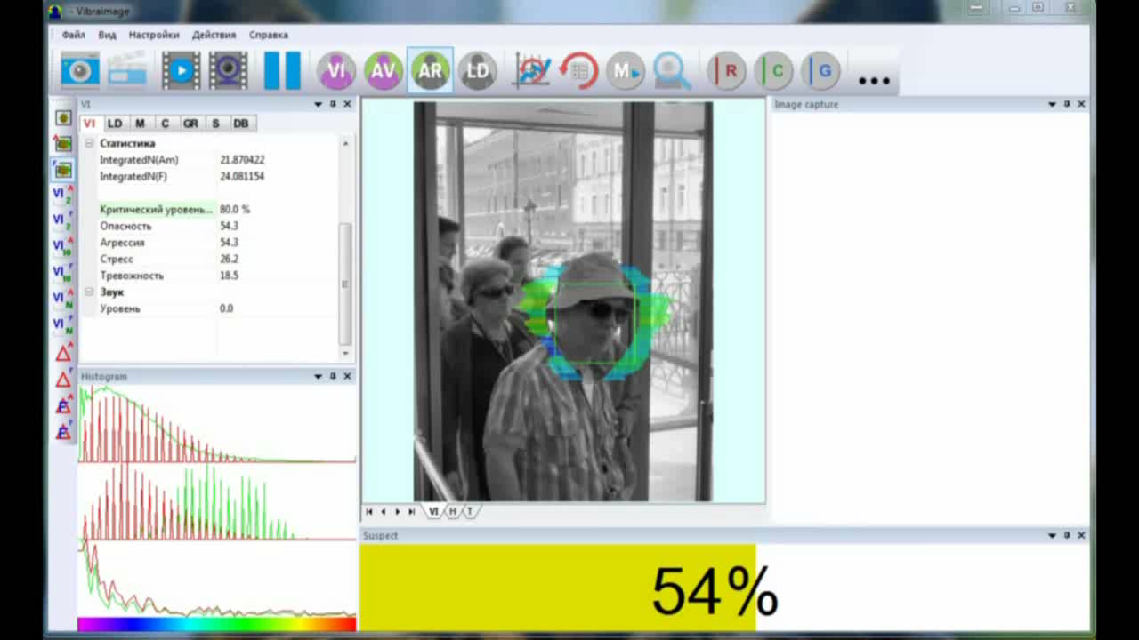
Vibraimage of a person. Security systems
Video of a suspicious person detection by Vibraimage PRO system, Mix mode. Moscow, the entrance to the Kremlin through the Kutafew Tower, 2017.
Notes:
The example of vibraimage operation as the security system is shown on this slide. Used Vibraimage PRO system works in Mix mode evaluating the potential danger level of a person closest to the camera. In case of exceeding the set threshold of the suspect level, the system automatically captures the photo of suspect on the left side of the screen and gives an alarm signal to operator. The operator separates the suspicious person from the main part of people and carries out actions to arrest the suspect in accordance with the established regulations.
A similar procedure was provided for using vibraimage systems at the Sochi Olympics. In the case of video processing on a separate server, the operator must give the command to the security to catch the suspect. The main advantages of vibraimage security systems are simple and friendly using, high speed and accuracy of suspicious person detection. The main disadvantages of vibraimage security systems are complexity of installation at objects and high requirements to stability of illumination.

Slide 8
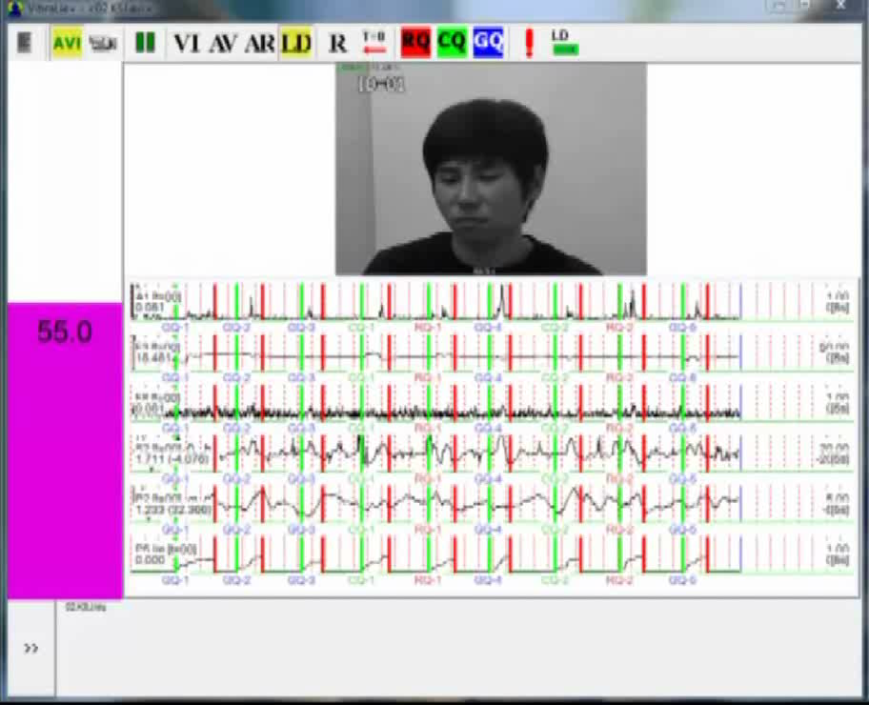
Vibraimage of a person. PDD
Psychophysiological detection of deception video. VibraLie program
Notes:
The next slide shows the example of vibraimage system works as a lie detector. After each answer of testee, the level of the question influence is determined and the result of detection in the form of False, True or Inconclusive (DI, NDI, INC) is displayed immediately after testing. Vibraimage technology gets more information about the subject than using a contact polygraph, which allows reducing the testing time, with giving the required accuracy. In addition, non-contact information from the video can significantly expand the possibilities of using lie detection technology.

Slide 9
Vibraimage of a person. Interviewing and self-testing
VibraMI and PsyAccent self test results
Notes:
The main advantage of the vibraimage technology in the study of personality is the ability to measure a person’s conscious and unconscious response when stimuli are presented.
Traditional methods of psychology are based only on analysis of a person’s conscious responses.
Traditional methods of psychophysiological testing are based on measuring physiological parameters, i.e. unconscious human reaction.
Vibraimage technology simultaneously determines conscious and unconscious responses, and the measurement takes place in physical values that allows addition and joint processing. The use and processing of conscious and unconscious responses as additive parameters significantly increase the information content of testing, since the personality of each person includes conscious and unconscious component. Using vibraimage was proved that conscious, unconscious components of personality are independent from each other, and do not have a correlation between themselves, and therefore the analysis of one of these components cannot determine the integral characteristics of personality.

Slide 10
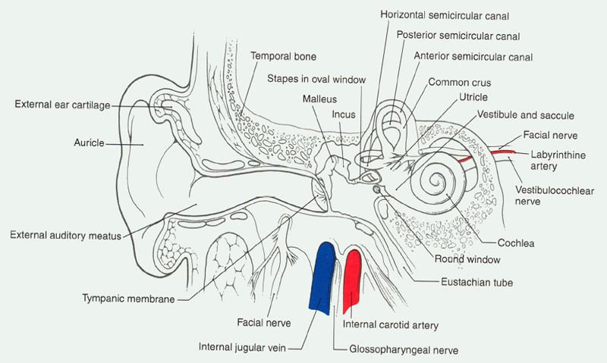

Human vibraimage. Medical diagnostics
Vestibular-emotional reflex - a sensitive indicator of physiological pathologies
Notes:
The basis of human vibraimage is vestibular system and vestibular-emotional reflex. The vestibular system is responsible for maintaining mechanical balance and is connected with all human organs. The presence of pathology in any human organ or physiological system is reflected in the work of the vestibular system, i.e. makes a definite imprint in the functioning of the vestibular system. The task of the vibraimage system when it used as a medical diagnostic system is to decode this imprint and convert it to a specific diagnosis.
Analysis of head micro-movements is so informative as functional diagnostics like EEG or biochemical analysis. However, to obtain a clear picture of every pathological imprint, is necessary to conduct large-scale studies that are comparable with similar medical studies of patients with specific pathology. Studies conducted in cooperation with Russian Scientific Center of Radiology showed the possibility of prostate cancer early diagnosis with the accuracy more than 90%. It opens the possibility of diagnostics for the other diseases using vibraimage technology.

Slide 11
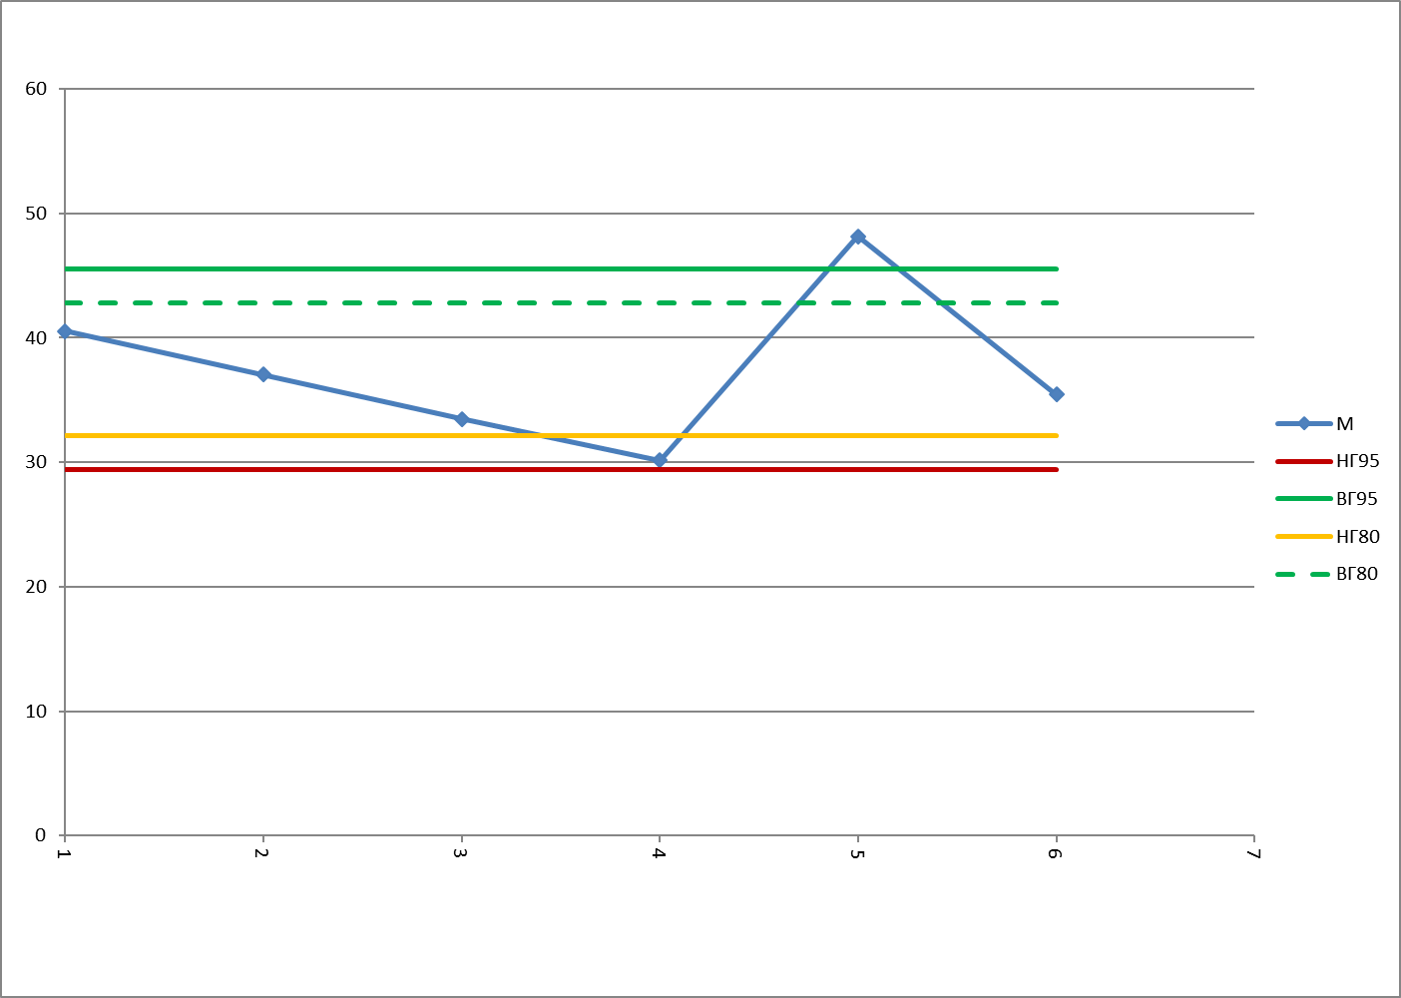
Human vibraimage. Preshift checking
VibraStaff program testing results. 60 second test
Notes:
VibraStaff program, developed jointly with the FMBC named after Burnazyan, carries out the pre-shift control of employees during one-minute testing. The program analyzes the changes in psychophysiological parameters of employee and their exit from individual norms, which makes it possible to prevent persons in inadequate condition from working, and this abnormality can be both medical and psychological. With the accelerating of technical progress, the value of human factor is increasingly contributing to the man-made disasters, therefore the importance of the pre-shift operator control is becoming increasingly important.

Slide 12
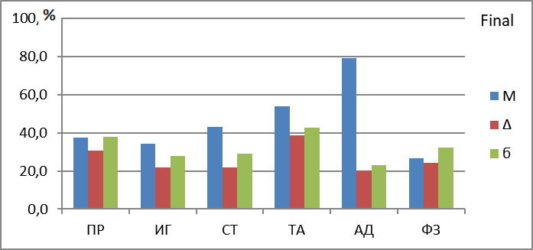
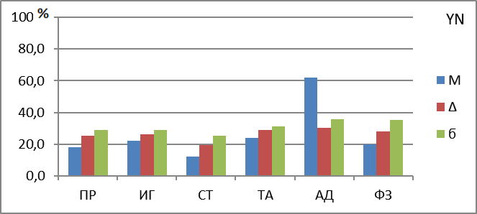
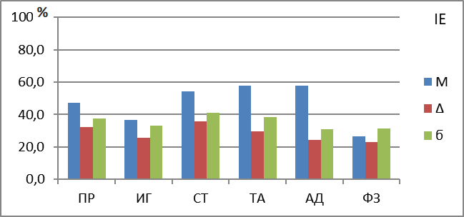
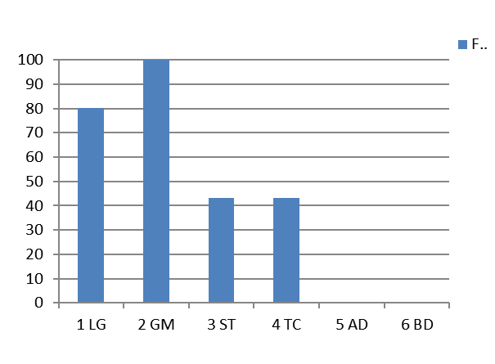
Human Vibraimage. Sport
N | % |  | Accentuation type
1 | 100 | GM | Game
2 | 80 | LG | legitimate
3 | 43 | TC | Tactics
4 | 43 | ST | Strategic
5 | 0 | BD | Bodily
6 | 0 | AD | Adaptive
Notes:
Despite the significant importance of the psychological component in modern sports, at the present time there are no objective non-invasive methods for monitoring the psychophysiological state of athletes. Especially important psychophysiological component is in team sports, where one player can ruin the game the whole team. Vibraimage technology allows the coach and the sports psychologist better represent the compatibility of players in a team and their capabilities in critical situations.
Operational control of the psycho-emotional and psychophysiological state of athletes during the game is also possible and allows optimizing game replacements. Psychophysiological control is used to optimize the training process and the selection of optimal loads. Currently, the VibraSport program is being tested in cooperation with Lesgaft’s University of Physical Culture team.

Slide 13
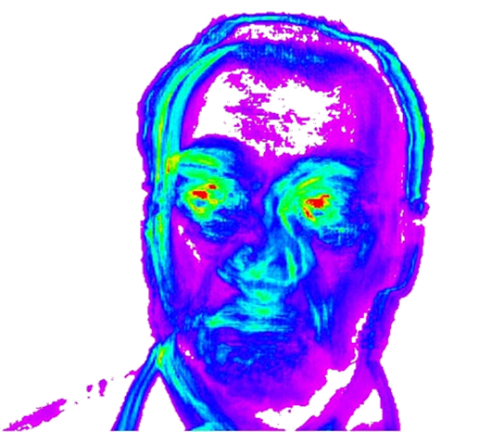
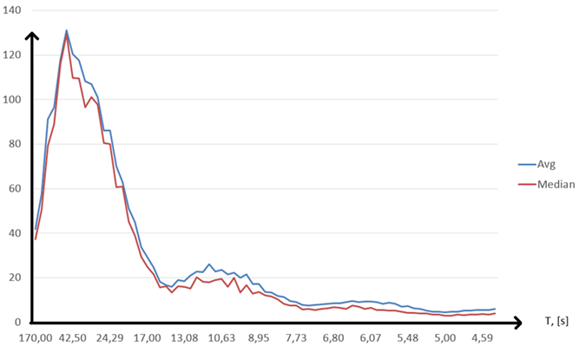
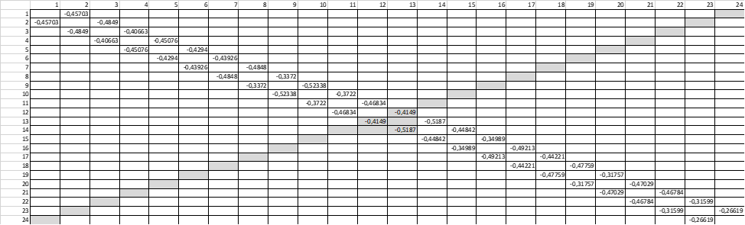
Human vibraimage. Scientific study
Human vibraimage
PPS spectrogram after FFT processing
Correlation matrix of unconscious responses statistics by
VibraMI program testing
Notes:
The unique properties of vibraimage technology allow to conduct scientific research at a new level and jointly process data about the conscious and unconscious components of personality. Almost over the past 150 years after the work of Ivan Mikhailovich Sechenov, “Brain Reflexes”, the human science has focused only on the accumulation of experimental data and there are no theories and hypotheses that explain and unify known phenomena. The phrase of Sechenov that “thought is the first two thirds of the mental reflex” did not receive further development and confirmation.
Unfortunately, modern psychophysiology after Sechenov and Pavlova could not transforms the thoughts, actions and behavior of a person to reflexes. In my opinion, this is due to the concentration of scientific research in narrowly specialized areas and the lack of connection between psychological and physiological (or biometric) research. Psychology is focused on the analysis of conscious component of personality, biometrics (including genetics) analyzes the biological unconscious characteristics of a person, and there are no common theories between these sciences.
While a personality includes conscious and unconscious characteristics, so is almost meaningless to analyze an object using only half of data about it. Vibraimage technology combines data on the consciousness and unconscious of a person in a single study and theory, which should lead to a breakthrough in many scientific and practical directions.

Slide 14
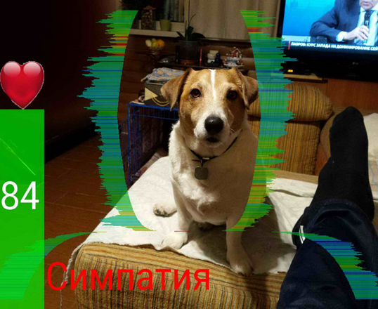
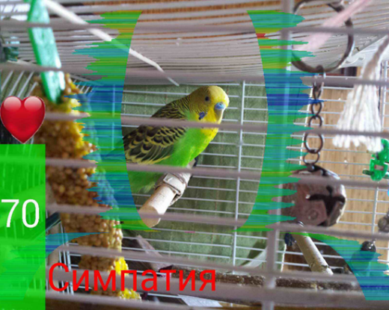
Vibraimage of animals
Image and vibraimage of laboratory rat
Game application Love Detector. Analysis of compatibility with animals
Notes:
At present, the analysis of animal’s vibraimage is only gaining, although in the future in terms of volumes it can seriously compete with applications based on vibraimages of people. People can exchange verbal information, and the vibraimage technology is used mainly to obtain hidden information about a person. At that time, as the animal can not say anything to the owner, and vibraimage can simplify the communication between human and animal. Moreover, the bases of vibraimage technology were founded by Darwin and Lorenz, who at the beginning analyzed the behavior of animals, and then transformed the findings to human’s behavior. We also did the first vibraimage study on rats more than 10 years ago.

Slide 15
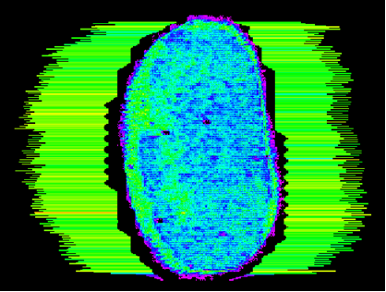
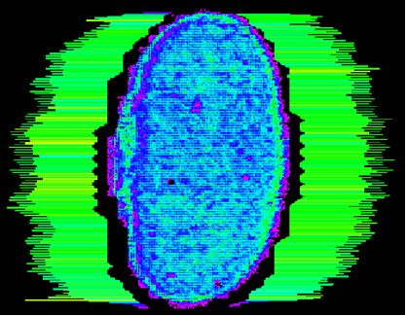
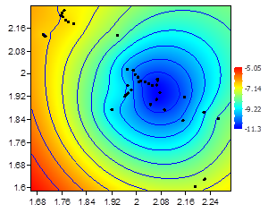
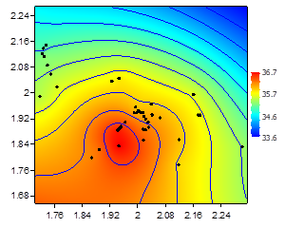
Vibraimage of biological objects
Living Seed (Phaseolus vulgaris L.)
Dead Seed (Phaseolus vulgaris L.)
Photos given by professor Jasper Zanco, Universidade do Sul de Santa Catarina
Normal seed
Seed subjected to microwave
Notes:
The vibraimage can reveal various physical properties of organic and inorganic objects, which in the first approximation have no connection with vibrations and movement. However, the fact that a real vibration image is noticeably different from the ideal has its own positive properties. Let me remind you that the ideal vibraimage reflects only the vibration characteristics of the object, and the actual vibraimage is a function of both the vibrations and the optical properties of an object.
The difference in optical properties, primarily at the edges of the object, makes it possible to reliably separate live seeds from the dead and genetically modified, which scientists in the Brazilian University of Santa Catarina have proved in their publications.

Slide 16
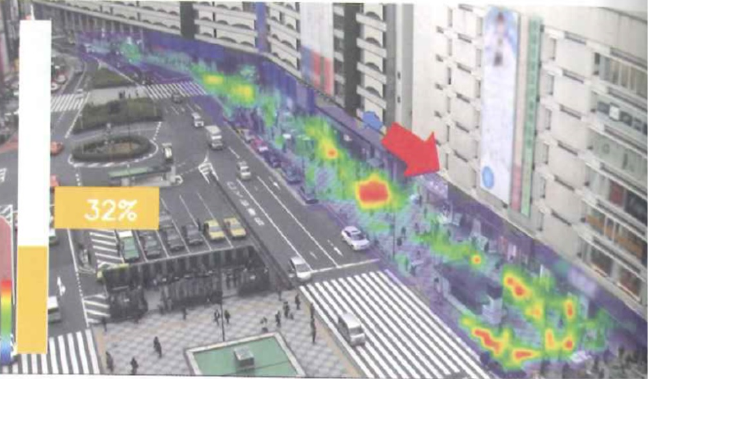
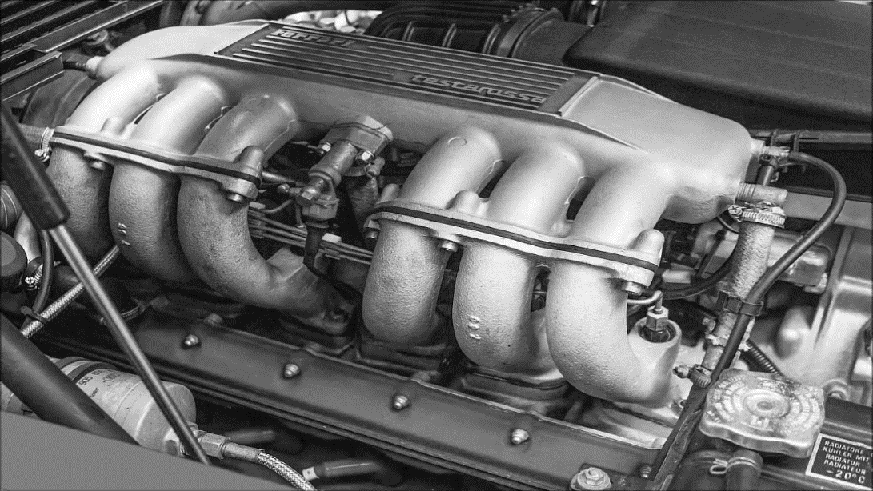
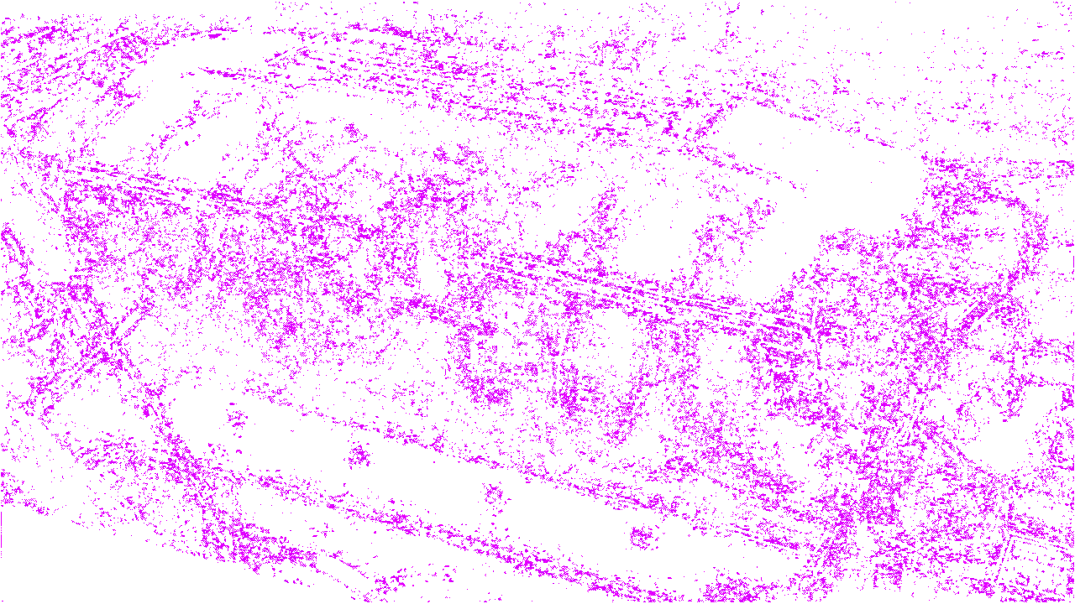
Vibraimage of non live objects.
Technical applications
Vibraimage traffic analysis.
Photo from the review 100 technologies changing future, NikkeiBP, 2017
Engine diagnostics with vibraimage technology
Notes:
Visual displaying and calculation of vibrations and movements parameters in the frame finds its application in the analysis of objects performing motion or vibrations. The slides show examples of using the vibraimage technology to adjust traffic in Japanese cities and the analysis of the engine vibrations during technical diagnostics of a car. Non-contact information about object vibration is used when testing the strength of large objects, such as buildings and bridges. Also, Elsys Corp has developed an earthquake warning program, which is installed on users' mobile phones.

Slide 17
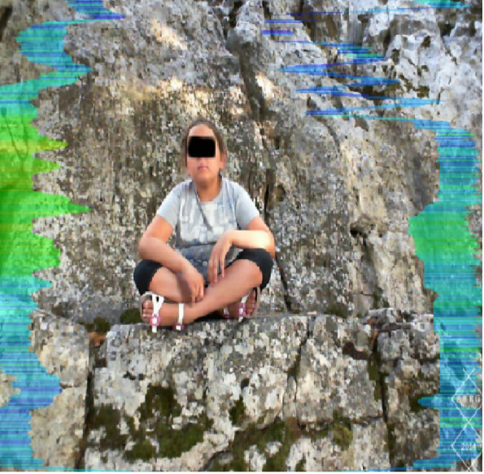
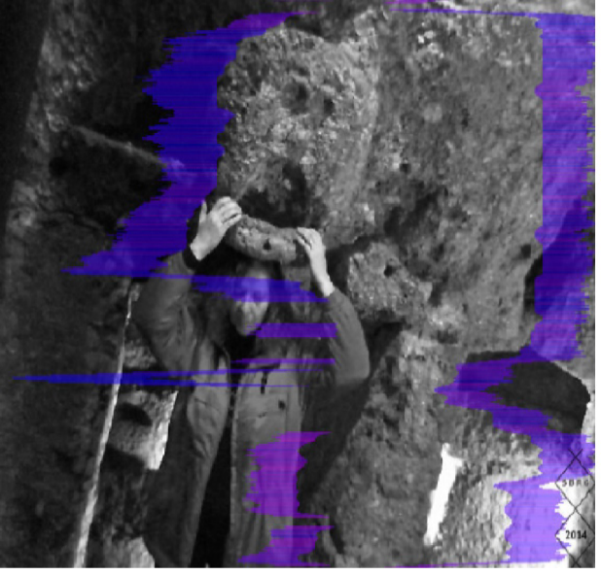
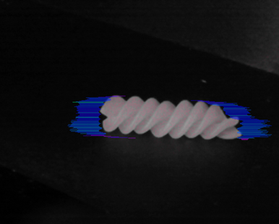
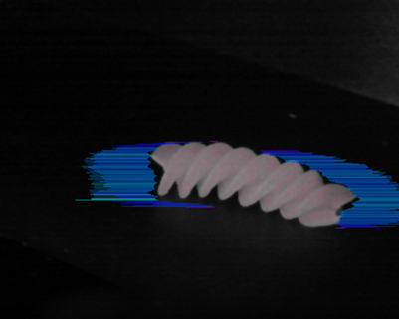
Vibraimage of inanimate objects.
Abnormal spaces research
Analysis of brain activity at archaeological sites
Images from the article Vibrations and natural phenomena in ancient sites affecting the brain activity. Prof. Debertolis&Gulla
https://pdfs.semanticscholar.org/de8d/5ae52424d940f801578493c91fc67c1e7463.pdf
Pasta after music processing of Mr. Vessicchio “Music makes tomatoes grow”. Sound, plants and Mozart: my life listening to natural harmony” Photos presented by Mr. Andrea Tommesani
Notes:
Some researchers use the vibraimage technology for the analysis of abnormal phenomena and mystical places. Moreover, the vibraimage technology allows to explore both human and non-living objects. With proper organization of experiments, such studies can identify the actual physical processes occurring on the object under study, because the vibraimage technology, due to its principle of operation, is very sensitive in detecting spatial irregularity in temporal processes, as evidenced by a number of publications by Italian scientists in the number of scientific journals.

Slide 18
Vibraimage perspectives
Mass solutions from vibraimage technology based on mobile phones. Voice control of vibraimage program
Increasing of vibraimage custom design programs and solutions
More vibraimage apps for science research
Development of new algorithms and solutions in vibraimage technology
Development of network and server solutions based on vibraimage technology
Notes:
At the last conference I talked about the relatively slow development of the vibraimage technology and explained the objective reasons of this process. It should be emphasized that the slow development is the normal way of development for scientifically based technology. During past 20 years, many others scientific discoveries have been arisen and disappeared, however vibraimage technology is slowly but surely finding more and more supporters, applications and users.
We are optimistic about the future and developing various areas of vibraimage technology applications. The increase in the number of reports at the 2nd conference also indicates an increase of the interest to vibraimage technology all over the world.

Slide 19
Thanks for the attention!
Viktor Minkin
e-mail: minkin@elsys.ru
www.elsys.ru
www.psymaker.com
Notes:
I thank all the colleagues participated in the second international scientific conference of vibraimage technology and I wish all the participants great scientific and practical success! I am sure that our next developments will make life safer, longer and happy with the help of vibraimage technology!

