Slide 1
Vibraimage technology application in psychology
Nikolaenko Yana, Ph.D

Slide 2
Psychometrics provides objective psychological research
Behavioral
Cognitive
Social
Existential-humanistic
Psychoanalysis
Psychology
Psychometrics
Notes:
In the report I would like to voice those practical aspects in using the technology of vibraimage, which can be useful in different areas of psychology. My task is to demonstrate that any product based on vibraimage technology is a good and reliable tool in the professional activity of a psychologist. Even if this specialist works in a certain direction and solves narrow professional problems. As examples, we consider 5 popular areas in psychology and show how to use the technology of vibraimage, taking into account the professional specificity of each of these areas.
The psychometric approach ensures the objectivity of the data obtained on the basis of the technology of vibroimage and allows us to solve practical problems of personality diagnostics for each of these areas.

Slide 3
Vibraimage technology in psychology & psychometrics
Observation
Anne Anastasi informed her methodological approach to psychometric testing: tests should be selected and used while bearing in mind their contextual appropriateness and limitations
Vibraimage
Testing
Vibraimage shows a real physical and psychophysiological phenomenon. This is a qualified tool of the psychologist, which allows you to minimize the number of errors in the diagnosis
Questionnaire
Notes:
Anne Anastasi, in her methodological approach to psychometric testing, says that tests should be chosen and used, given their feasibility and limitations. Accordingly, the psychometric approach to assessing the reliability and validity of psychological methods, in our opinion, is basic. Any of the products based on the vibraimage technology allows to minimize the number of errors in the psychologist’s activities, can be used as an independent tool and in combination with traditional psychological diagnostics tools (questionnaires, tests, etc.).

Slide 4
Standards for Educational and Psychological Testing & Vibraimage technology
conscious
Psychological testing = Standards for Educational and Psychological Testing
Sigismund Freud
psychoanalysis
unconscious
Léopold Szondi
Szondi test
Vibraimage technology
Notes:
The Standards for Educational and Psychological Testing (as amended in 2014), are still focused on structuring the criteria of reliability and validity of predominantly traditional psychological methods. The main problem lies in the fact that the developed criteria of validity and reliability are focused on psychological methods that diagnose the sphere of the conscious. While there are well-known methods and techniques, the purpose of which is the diagnosis of the unconscious sphere (psychoanalysis, the fate of the analysis of Sondi and others). And in this case, the criteria of validity and reliability, which are referred to in the Psychological Standards of 2014, cease to work. Vibraimage technology covers both of these areas: conscious and unconscious. Therefore, the criteria of reliability and validity, according to which it is customary to evaluate current psychological standards, cannot be used in full with respect to this technology.

Slide 5
Behavioral psychology with VibraMed (Excel_M file)
Burrhus Skinner said about behavioral psychological: that the science of human behavior is not fundamentally different from any other science based on facts. Its purpose is to predict and control the phenomenon under study.
 | M | S | Vi (S/M) | bMin | cMin | bMax | cMax
Aggression | 48,61 | 13,16 | 27,07 | 20,00 | 4,07 | 50,00 | 60,83
Stress | 22,04 | 4,64 | 21,06 | 20,00 | 11,23 | 40,00 | 32,19
Tension | 9,82 | 15,98 | 162,62 | 15,00 | 1,35 | 40,00 | 49,89
Suspect | 28,22 | 8,89 | 31,51 | 20,00 | 6,43 | 50,00 | 44,30
Balance | 69,82 | 8,85 | 12,68 | 50,00 | 54,37 | 100,00 | 99,58
Charm | 79,46 | 5,63 | 7,09 | 40,00 | 64,47 | 100,00 | 86,82
Energy | 28,94 | 12,23 | 42,28 | 10,00 | 2,48 | 50,00 | 50,05
Self-Regulation | 75,04 | 6,72 | 8,96 | 50,00 | 49,79 | 100,00 | 89,93
Inhibition | 26,68 | 6,47 | 24,25 | 10,00 | 9,57 | 25,00 | 45,66
Neuroticism | 64,69 | 19,95 | 30,84 | 10,00 | 4,40 | 50,00 | 70,35
Positive | 63,31 | 46,5% | 17,75 | 16,8%
Negative | 27,17233 | 20,0% | 60,566 | 57,2%
Physiological | 45,68135 | 33,5% | 27,5444 | 26,0%
Notes:
Consider the possibility of the practical use of vibraimage technology on the example of individual psychological schools. The first direction (school): Behavioral. The behavioral direction of psychology studies the behavior of a person as the main indicator of his personality. Accordingly, the psychodiagnostic tool should have high predictive accuracy, based on criteria that can be checked in real time. This is most conveniently done using the VibraMed program or one of the Excel_M files, capturing based on different vibraimage programs. This M file indicates 10print of emotions or ten psychophysiological parameters of person state (PPS).

Slide 6
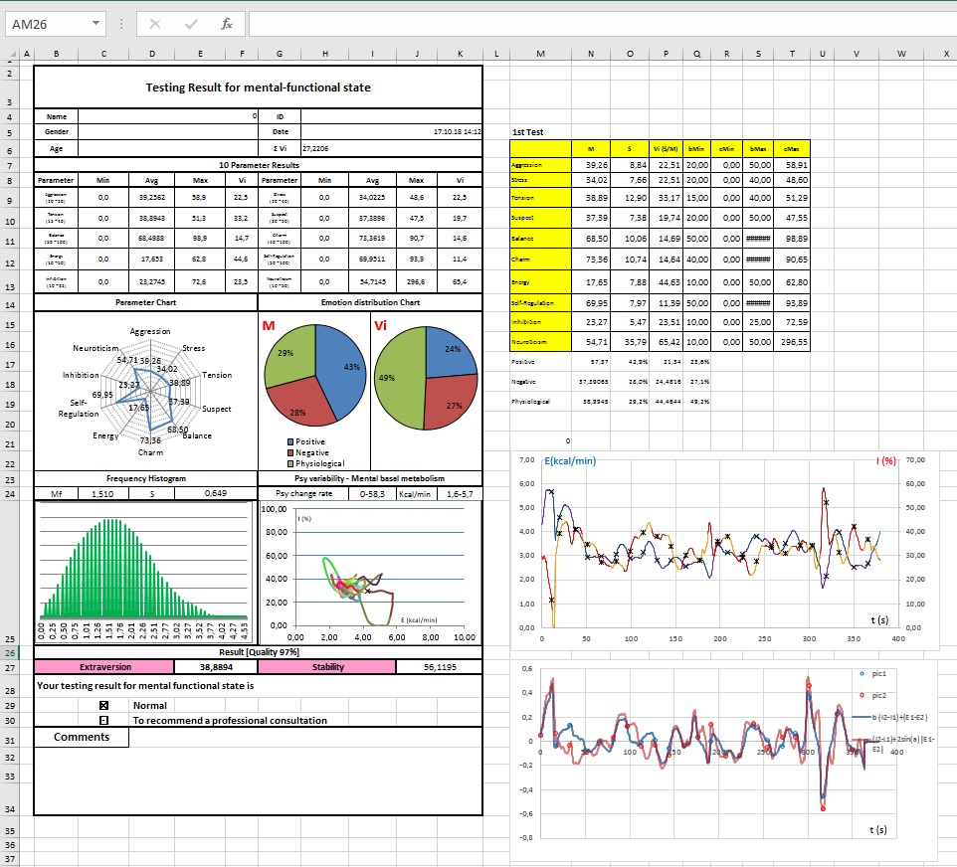
Behavioral psychology with VibraMed (Excel_M file)
The forecast of human behavior can be made based on:
Express diagnostics - psychophysiological state (PPS), excel_M file
Comprehensive personality assessment (PsyAccent and VibraMed, or programs include the excel_M file)
Notes:
Express diagnostics of PPS and complex personality assessment have different goals. Comprehensive diagnosis of an individual reveals an individual whose behavior poses a threat to society or the individual in certain circumstances, which are also named as "vulnerable spot“.
Express diagnostics allows to predict the probability of destructive behavior in the next few minutes.

Slide 7
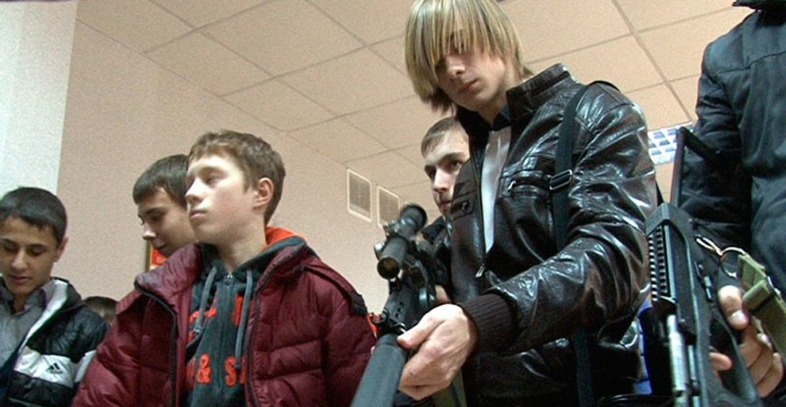
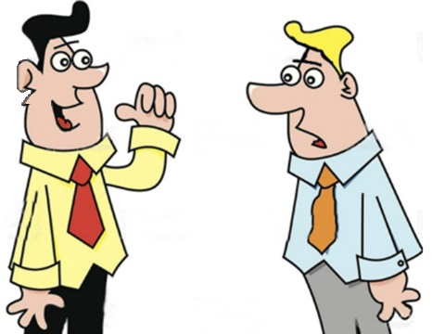
Behavioral psychology Express diagnostics: PPS
This man is aggressive?
Yes! He has a gun
Экспресс диагностика ПФС, при помощи VibraMed.
Correct answer:
This man is not aggressive. He is perceived as aggressive. Is it possible? Yes. For example, in dash
Notes:
In what specific case can a express diagnosis of PPS be useful? For example, the differentiation of dangerous and safe situations: when a person looks aggressive, but is not such, or vice versa

Slide 8
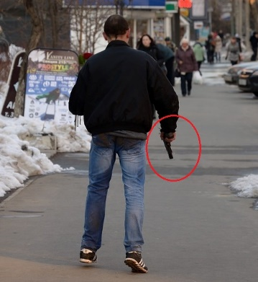
Behavioral psychology and personality
Operant conditioning (also called instrumental conditioning) is a learning process through which the strength of a behavior is modified by reinforcement or punishment, Burrhus Skinner
“Thorndike law of effect”, which states that behaviors followed by satisfying consequences tend to be repeated and those that produce unpleasant consequences are less likely to be repeated. In short, some consequences strengthen behavior and some consequences weaken behavior, Edward Thorndike
But neither Thorndike nor Skinner could determine which people are more and which are less susceptible to negative impact. Complex personality assessment with PsyAccent and VibraMed can do it
Notes:
With a comprehensive assessment of the individual, in contrast to the PPS, the goals are the others. For example, Skinner's Operant Learning or Thorndike's Law suggests that in the process of gaining a specific repetitive experience, the behavioral model of response is reinforced.
The authors themselves explore the incentives and reactions to them of man. But neither Skinner nor Thorndike could determine which people were more or less influenced. However, this can be done with a comprehensive assessment of the personality using the PsyAccent program.

Slide 9
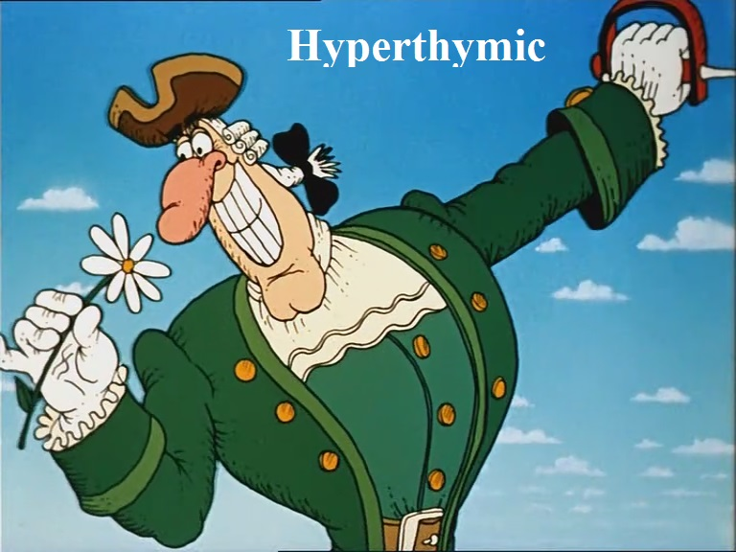
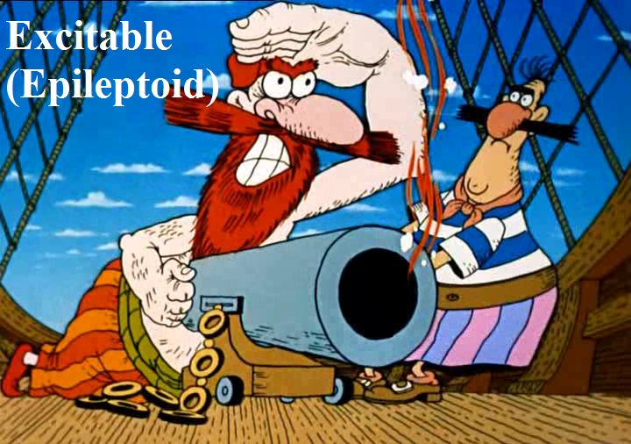
Behavioral psychology and PsyAccent
Accentuations of character …
Karl Leonhard (1968):
«Accentuation is, in essence, the same individual traits, but having a tendency to transition to a pathological state»
Notes:
Проблема диагностики пограничных психических расстройств является одной из центральных проблем психиатрии и психологии, а также ее отдельных отраслей.
Акцентуации традиционно понимается как крайний вариант нормы проявления характера, при котором отдельные черты усилены, а другие наоборот – ослаблены. Такой человек может оказаться более подвержен негативному влиянию, чем другие люди без акцентуаций характера.

Slide 10
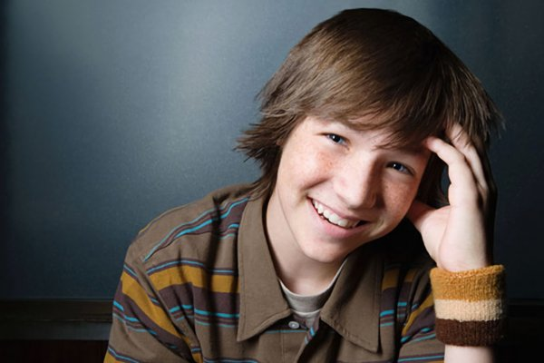
Behavioral psychology and PsyAccent
Questionnaires:
The PsyAccent program contains 3 questionnaires:
• L12 - for adults (developed with reference to the concept of K. Leonhard)
• T12 - for adolescents and young men (developed with the support of A.Y. Lichko's concept)
• PA - to determine the psychological compatibility of the patient and the doctor (developed with the support of A. Gnezdilov A.V concept)
Notes:
The PsyAccent program (PA) contains 3 questionnaires: L12 - for adults, T12 - for adolescents and young men, PA - to determine the psychological compatibility of the patient and the doctor. During the development of PsyAccent, we tried to take into account the main features of the age-related dynamics of character accentuations, as well as the likelihood of a complex life situation - such as late disease, which has a malignant course. The PA questionnaire is intended to help medical workers whose specialization is the treatment of malignant tumors.

Slide 11
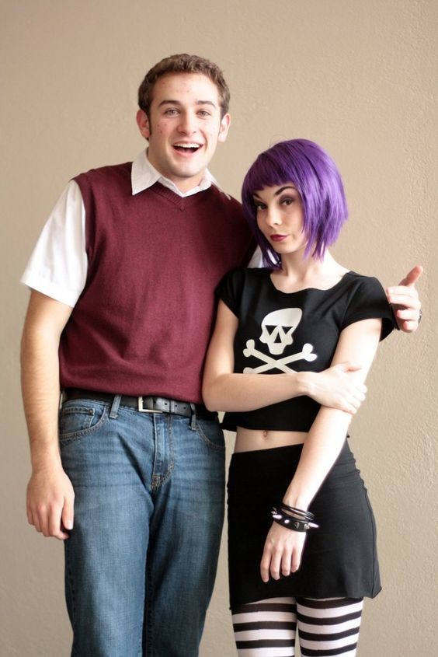
Behavioral psychology and PsyAccent: contents, tabs
L12 – for adults
Questionnaires L12 contains the following main tabs:
The main feature
Vulnerable place
Compatibility
Notes:
The L12 questionnaire includes the following main tabs:
General profile of personality accentuations
Weak spot for each type
Table of potential compatibility of carriers of various types of character accentuations

Slide 12
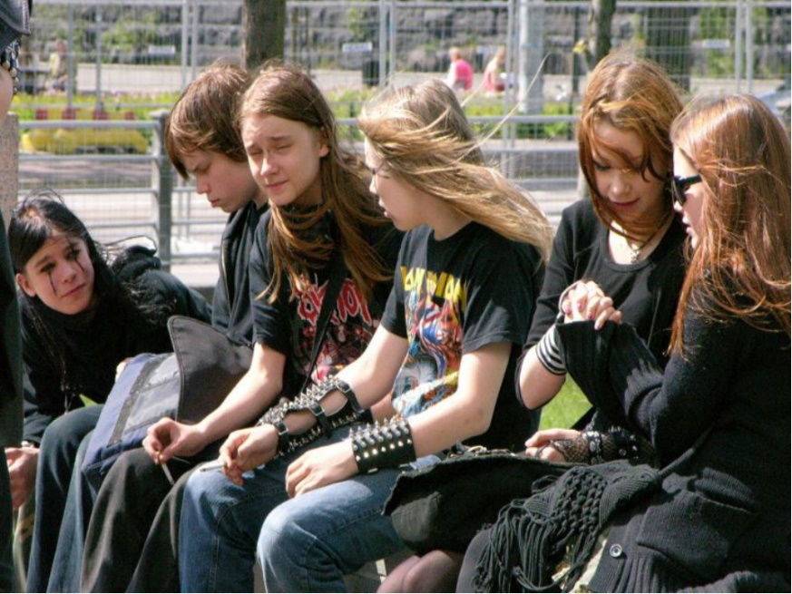
Behavioral psychology and PsyAccent: contents, tabs
T12 - for adolescents and young men
Questionnaires T12 contains the following main tabs:
The main feature
Vulnerable place
Risk group
Notes:
The T12 questionnaire includes the following main tabs:
General profile of character accentuations
Weak spot for each type
Risk group

Slide 13
Cognitive & Social (The Social Cognitive Theory ) with PsyAccent
Cognitive and Social theory most popular in a Social Cognitive Theory by Albert Bandura - originator of social learning theory
Notes:
Consider the cognitive and social model, in the aspect of the theory of social learning by Albert Bandura. The most susceptible to various social influences are usually: unstable and conformal type. The tendency to wrongdoing was noted in individuals with epileptoimidous, hysteroid types of accentuation, as well as in different variants of their combinations.

Slide 14
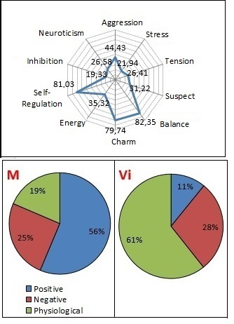
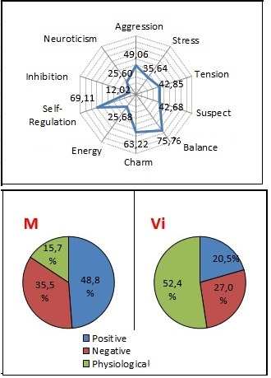
Cognitive & Social (Social Cognitive Theory ) psychology with VibraMed
Example 1. Hyperthymic
Example 2. Epileptoid
Notes:
PsyAccent data is recommended to compare with the prevalence of negative emotions by VibraMed. As can be seen from the figure, people with epileptoid accentuation have a rather high percentage of negative emotions - 35.5%, and what is important - the level of control over them is weak, i.e. poorly expressed physiological reactions (inhibition and neuroticism) - 15.7%. With that, positive emotions in general prevail over negative ones. There is significant variability in both positive and negative emotions, which indicates a general emotional instability of such a person (Vi). On the contrary, in the hyperthymic personality type, positive emotions predominate over negative ones, with their small variability, i.e. positive emotions are persistent.

Slide 15
Existential-humanistic psychology with VibraMI & PsyAccent
Personality as a unique holistic system. This approach emphasizes individuals' inherent drive towards self-actualization, the process of realizing and expressing one's own capabilities and creativity, Abraham Maslow, Carl Rogers
Notes:
Another area that we will consider is the Existential-Humanistic Psychology of Abraham Maslow and Carl Rogers. This is one of the most positive trends in psychology. It recognizes the unlimited possibilities of a person for self-improvement, including professional. Where a person and a profession merge into one. Properly chosen profession corresponds to the abilities of the individual, brings joy and pleasure. Accordingly, the approach to the assessment of abilities should also reflect the basic principles of humanistic psychology.

Slide 16
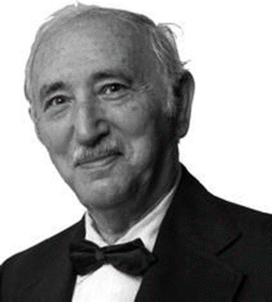
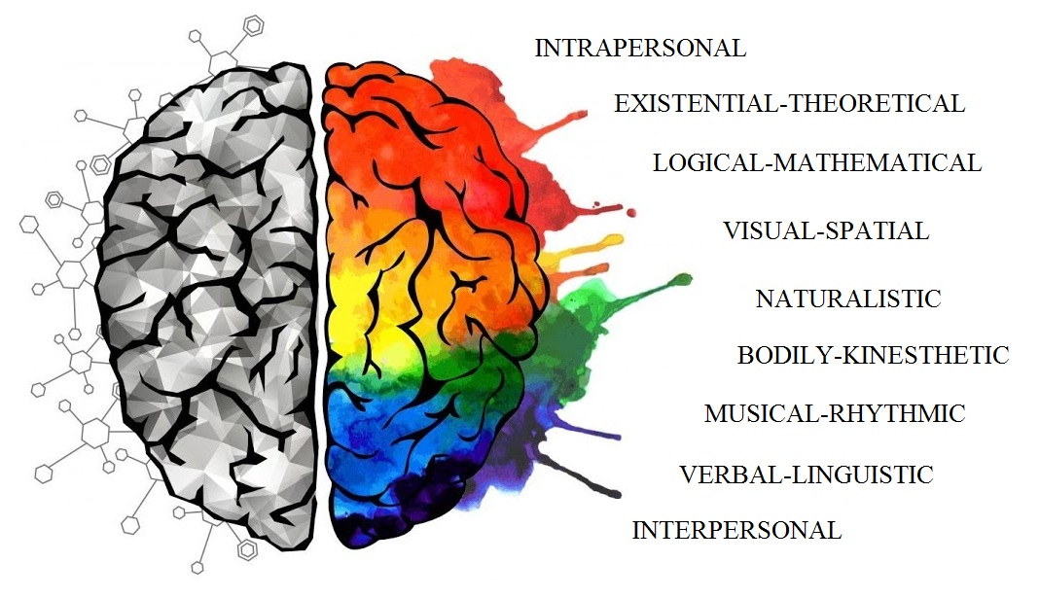
Existential-humanistic psychology and abilities
IQ or Multiple Intelligences?
IQ
MI
David Wechsle
He developed well-known intelligence scales, such as the Wechsler Adult Intelligence Scale (WAIS)
Howard Gardner The author of the Multiple intelligence concept
Notes:
In this regard, the most acute question is how to assess human abilities. "Intellect" and "abilities" - parts of a one whole or independent variables? The analysis of ability tests implies a certain relation to these concepts. Traditional tests of special abilities in fact measure various aspects of the intellect that ensure effectiveness in specific narrow areas of activity. However, the intelligence itself is understood as an indivisible whole - “general intelligence”, reflected by IQ rates. On the contrary, according to the Gardner theory of multiple intelligences (Gardner, 1983), it is not about “aspects of intelligence”, but about independent, discrete forms of intelligence, i.e multiple intelligence (MI). Thus, the author of the concept of MI denies an approach in which the intellect is considered as an indivisible whole, as measured by classical IQ tests. Each of the 7 basic types of MI is a special way of interacting with the surrounding reality, reflecting the ability to a particular field of study. This model of intelligence allows you to effectively predict the focus of professional activity in the most comfortable (in terms of self-actualization) areas of study.

Slide 17
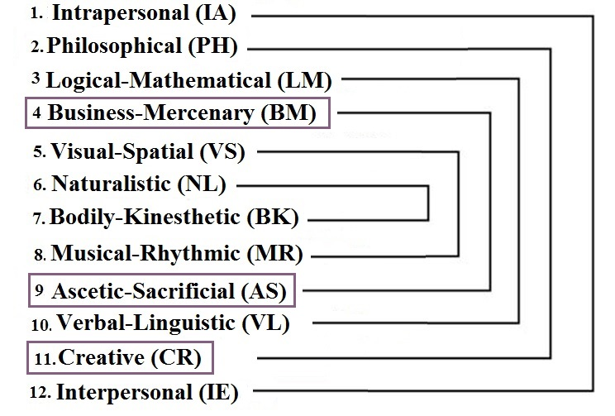
Existential-humanistic psychological and abilities
Extended and amended Gardner`s classification structure of Multiple Intelligences
Notes:
The program VibraMI, based on the technology of vibraimage, presents a supplemented and expanded to 12 types of classification of multiple intelligences of Gardner, with an indication of the possibility of self-realization in a particular professional field. The classification is supplemented by business-selfish, ascetic and creative types of MI. Questionnaire in 24 questions, diagnoses the rating of each of the multiple intelligences on the basis of the current psychophysiological responses and the conscious answers of the subject. The resulting profile of multiple intelligences can be viewed from the perspective of an individual profile of abilities, sphere of interests and preferences.

Slide 18
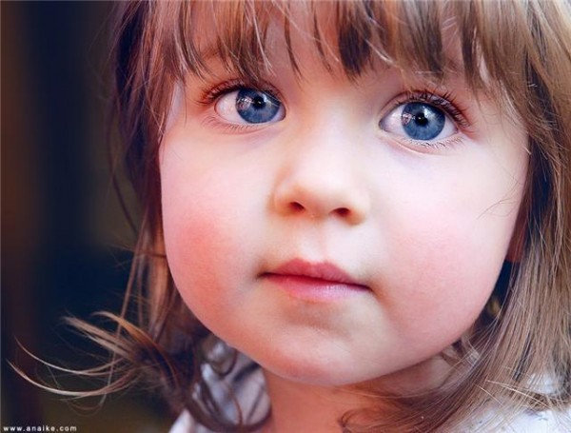
Existential-humanistic psychological and abilities VibraMI: questionnaires:
Gardner_12 Eng – questionnaire is intended to identify
the human abilities and field of specialization (14+)
Gardner_12S Eng – questionnaire is intended to identify the human abilities and outside interest (pre-professional hobbies, second specialty)
Gardner_12T Eng- questionnaire is intended to identify for adolescents and young men abilities and field of specialization (12+)
Gardner_12S5 Eng- questionnaire is intended for 5-11 years old kids testing, to identify the human abilities (5+)
Notes:
Current VibraMI program has 4 different questionnaires for the different ages of tested persons.

Slide 19
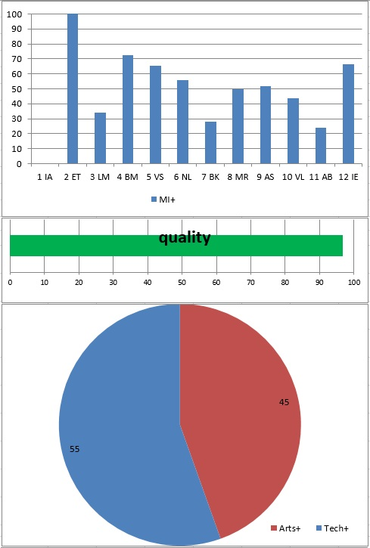
Existential-humanistic psychology and abilities Final result:
N | % |  | Intelligence profile
1 | 100 | BM | Business-Mercenary (BM)
2 | 90 | MR | Musical-rhythmic (MR)
3 | 89 | CR | Creative (CR)
4 | 88 | VS | Visual-spatial (VS)
5 | 83 | IA | Intrapersonal (IA)
6 | 67 | IE | Interpersonal (IE)
7 | 54 | BK | Bodily-kinesthetic (BK)
8 | 46 | LM | Logical-mathematical (LM)
9 | 44 | VL | Verbal-linguistic (VL)
10 | 31 | NL | Naturalistic (NL)
11 | 11 | PH | Philosophical (PH)
12 | 0 | AS | Ascetic-Sacrificial(AS)
Notes:
At the end of the 6th minute test, the VibraMI system generates the results of a study, as an Excel file. Thus, there is no need to spend time on the calculation and processing of results. And, most importantly, the so-called "human factor" is completely excluded, the likelihood that a person made a mistake when manually processing the results is zero. In total, the VibraMi system generates 12 files, with many tabs. The content of each tab carries the analysis of data that may be useful in drawing up the profile of a testee by specialists in various fields.

Slide 20
Existential-humanistic psychology Conscious+ Unconscious responses= reduced MI profile
Conscious MI profile
Unconscious MI profile
General MI profile
Notes:
The Multiple Intelligences profile is presented on the Final` graph, which is obtained by summing up the conscious responses and the psychophysiological reaction to them (PPS), (the reduced values ​​are used).
The graph YN reflects the data of conscious answers of the subject, on the graph IE - psychophysiological (unconscious) responses.

Slide 21
Existential-humanistic psychology & VibraMI
 | % | № | Broad field
1 | 67 | 06 | Information and Communication Technologies (ICTs)
2 | 66 | 07 | Engineering, manufacturing and construction
3 | 55 | 01 | Education
4 | 54 | 04 | Business, administration and law
5 | 52 | 10 | Services
6 | 51 | 03 | Social sciences, journalism and information
7 | 48 | 05 | Natural sciences, mathematics and statistics
8 | 45 | 02 | Arts and humanities
9 | 41 | 09 | Health and welfare
10 | 36 | 08 | Agriculture, forestry, fisheries and veterinary
 | % | № | Skills
1 | 83 | 0314 | Sociology and cultural studies
2 | 83 | 0716 | Motor vehicles, ships and aircraft
3 | 78 | 0711 | Chemical engineering and processes
4 | 78 | 0712 | Environmental protection technology
5 | 69 | 0311 | Economics
6 | 69 | 0721 | Food processing
7 | 69 | 0722 | Materials (glass, paper, plastic and wood)
8 | 69 | 0723 | Textiles (clothes, footwear and leather)
9 | 69 | 0724 | Mining and extraction
10 | 67 | 0611 | Computer use
 | % | № | Narrow field
1 | 69 | 072 | Manufacturing and processing
2 | 67 | 061 | Information and Communication Technologies (ICTs)
3 | 64 | 103 | Security services
4 | 64 | 071 | Engineering and engineering trades
5 | 63 | 031 | Social and behavioral sciences
6 | 62 | 042 | Law
7 | 55 | 011 | Education
8 | 55 | 023 | Languages
9 | 54 | 041 | Business and administration
10 | 54 | 084 | Veterinary
Notes:
On the basis of the multiple intelligences profile, data on the recommended specialty is automatically generated: wide area, narrow and speciality.

Slide 22
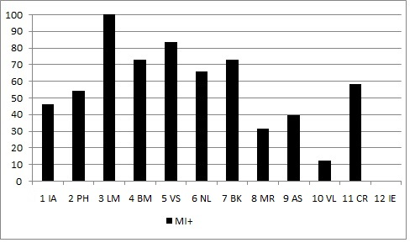
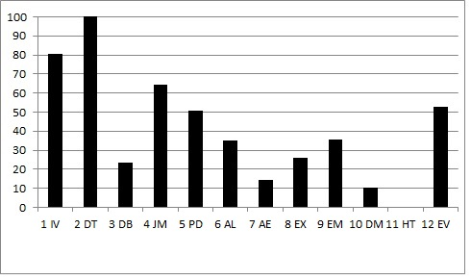
Existential-humanistic psychology
Sample of successful person MI (left) and PA (right) profiles
Notes:
A successful person has a professional activity that corresponds to his abilities and personal qualities. These are MI and PA profiles of a young male engineer. He successfully combines his work with running a businessman - selling bicycles. As can be seen from the profile of MI: the leading ability of the LM, VS and BM.
What is important, the profile of accentuations did not reveal, for example, hysterical features that could be considered as undesirable for doing business. On the contrary, the dysthymic type of accentuation prevails.

Slide 23
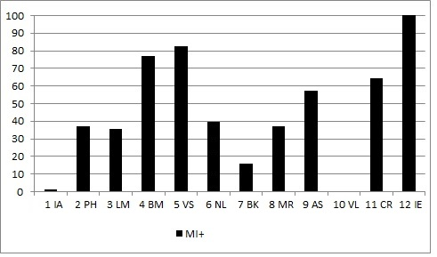
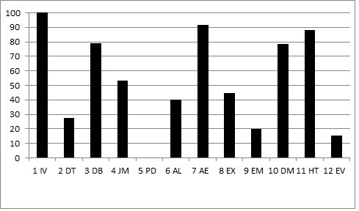
Existential-humanistic psychology
Sample of unsuccessful person MI (left) and PA (right) profiles
Notes:
An example of unsuccessful MI and PA person profiles. A young male professional is an engineer. Dreams of becoming a businessman. According to the profile of MI, we see that LM abilities are poorly developed. Well expressed BK MI. At the same time, the presence in the profile of personality accentuations of leading affective-exalted, hysteroid and hyperthymic traits does not coordinate to do business. This circumstance is aggravated by the fact that the acquired profession does not correspond to the profile of abilities.

Slide 24
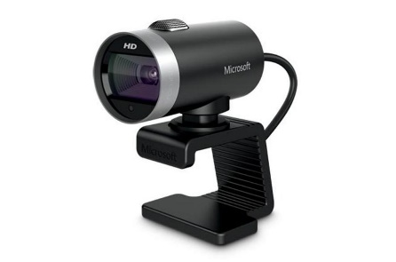
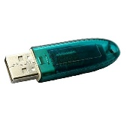
Psychoanalysis & Vibraimage technology
(VibraMI)
If we consider the answers of the test subject as a criterion of conscious attitudes, then certainly there are unconscious attitudes. Unconscious attitudes are much less plastic than the conscious ones because they are not attached to a situational factor. The vibraimage allows you to register in real time, both conscious and unconscious "answers" to the questions of the questionnaire.
Notes:
The vibraimage technology is one of the modern technologies that allows real-time tracking of the dynamics of psychophysiological reactions of a person on a number of parameters. If we consider the answers of the test subject as a criterion of conscious attitudes, then certainly there are unconscious attitudes. Unconscious attitudes are much less plastic than the conscious ones because they are not attached to a situational factor.
The vibraimage allows you to register in real time, both conscious and unconscious "answers" to the questions of the questionnaire.
This approach allows achieving greater predictive accuracy than the traditional survey method. The test results are more stable than in the traditional questionnaire because they reflect the average values between conscious and unconscious attitudes

Slide 25
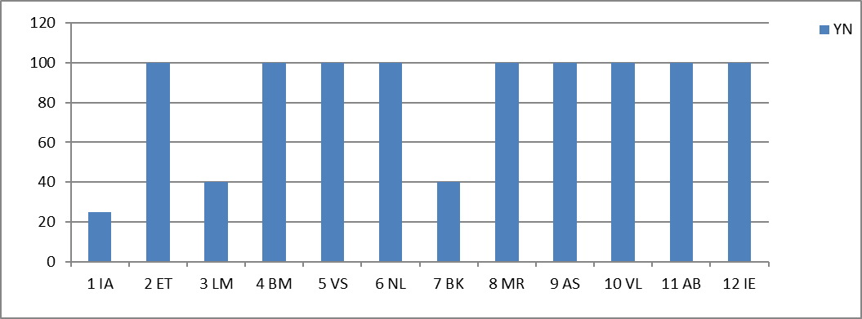
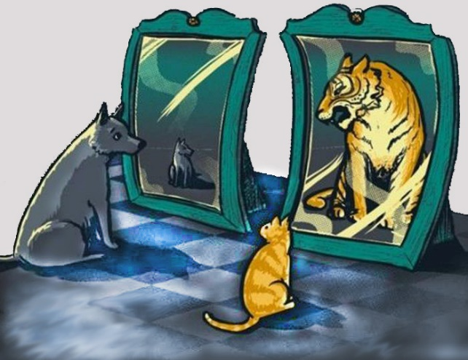
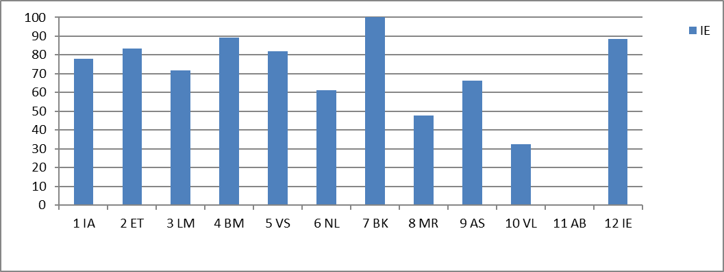
Psychoanalysis: conscious and unconscious
Conscious answers are a reflection of self-esteem. Where, by self-esteem, is understood a complex mental education mediated by unconscious drives and complexes (including fear of inconsistency)
Conscious answers (YN)
Unconscious «answers» (IE)
Notes:
Conscious answers of the person reflect his self-esteem. At the same time, self-esteem is a complex mental education, which is not limited to the conscious person’s self-image. His unconscious realm (fears, instincts, repressed desires) can influence conscious responses to one degree or another. The degree of this influence is determined by the depth of the conflict between the desired and the actual. The deeper this discrepancy, the greater the influence of the sphere of the unconscious on conscious responses.

Slide 26
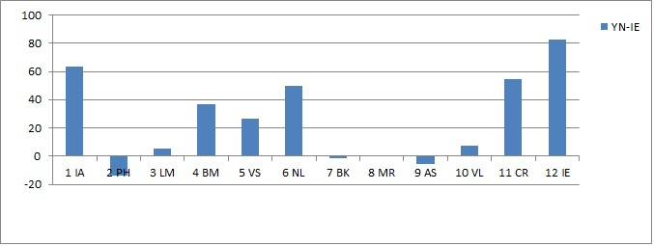
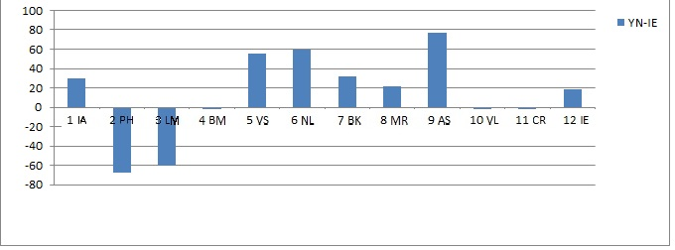
Psychoanalysis: the conflict between conscious and unconscious
Conscious answers (YN) minus unconscious «answers» (IE)
Example 1: no conflict between conscious and unconscious
Example 2: conflict between conscious and unconscious
Notes:
A range from 20% to -20% is considered a match between the desired and the actual (example 1). Negative values ​​greater than -20% should be understood as the most significant parameters of the unconscious. While the excess of a positive value of 20% can be considered as significant parameters of the conscious sphere. This is one of the possible interpretations of the subject's conscious and unconscious responses.

Slide 27
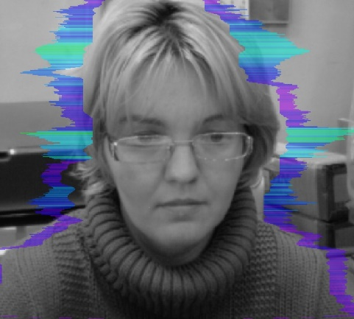
Vibraimage technology is Validity and Reliability psychological method
Naturalistic observation, and laboratory observation
Psychological testing
Vibraimage technology
Notes:
In conclusion, I would like to say that, along with the other traditional methods of psychological testing, the technology of vibraimage can also claim to be a valid and reliable tool in various areas of psychology. The main advantage of vibraimage is the ability to process conscious and unconscious information of a testee in the real time testing. This important ability is impossible for the other technologies.

Slide 28
Thank you for your attention!
Nikolaenko Y.N.
Ph.D
www.elsys.ru
www.psymaker.com
www.kqelsys.com elsys@kqelsys.com
Notes:
Thanks for you attention and welcome with questions!

